Slide 1


The ATLAS trigger
Ricardo Gonçalo
Royal Holloway, 14 January 2009

Slide 2
Outlook
The LHC and the ATLAS experiment
The ATLAS trigger system
  Level-1 Trigger
  High-Level Trigger
  Trigger Menu and Configuration
  Trigger Performance
Commissioning of the ATLAS trigger
  “Technical runs”
  Operation with first beam
  Trigger performance in cosmic runs

Slide 3
The LHC and the ATLAS Detector

Slide 4
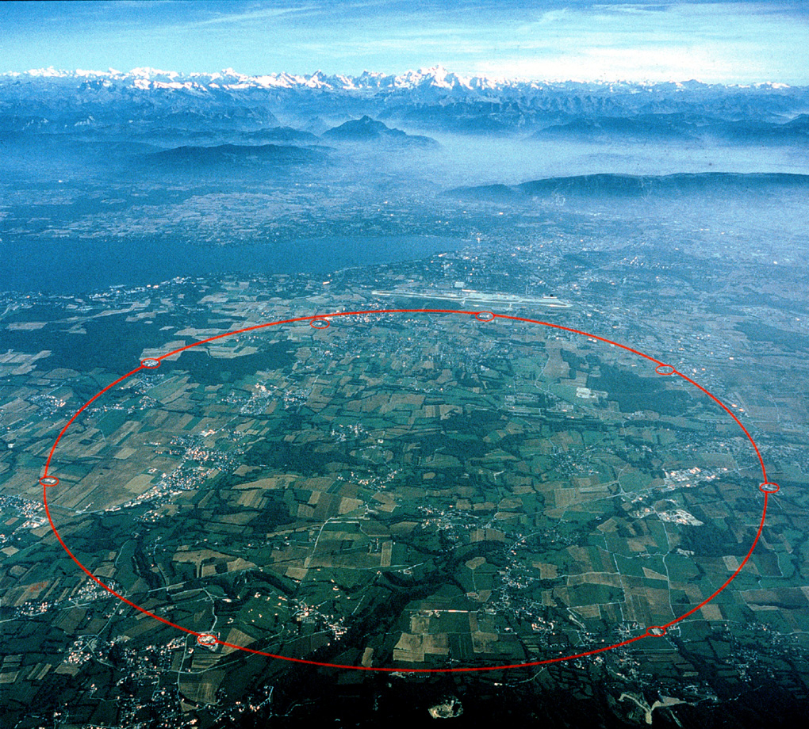

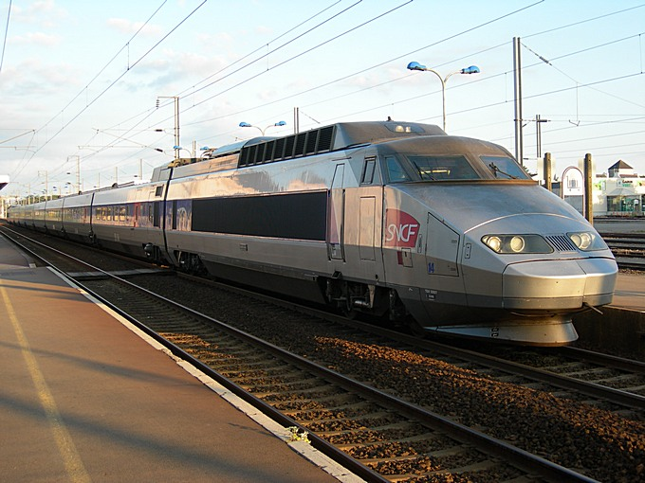
The Large Hadron Collider
The LHC started operating on September 10th last and will resume in July/August this year
Four main experiments:
  ATLAS and CMS – general-purpose
  LHCb – B physics
  ALICE – heavy-ion physics
CM energy | 14 TeV (design)
Luminosity (cm⁻²s⁻¹) | Low: 2x10³³ High: 10³⁴
Bunch crossing | 24.95 ns
Overlaid events | 23 @ 10³⁴cm⁻²s⁻¹
Beam radius | 16.7 μm
Particles/bunch | 1.15x10¹¹
Bunches/beam | 2808 (design)
Stored energy | 362 MJ/beam
20,000 tonne aircraft carrier at 21.6km/h (13.4mph)
400 tonne TGV travelling at 150km/h (94mph)

Slide 5
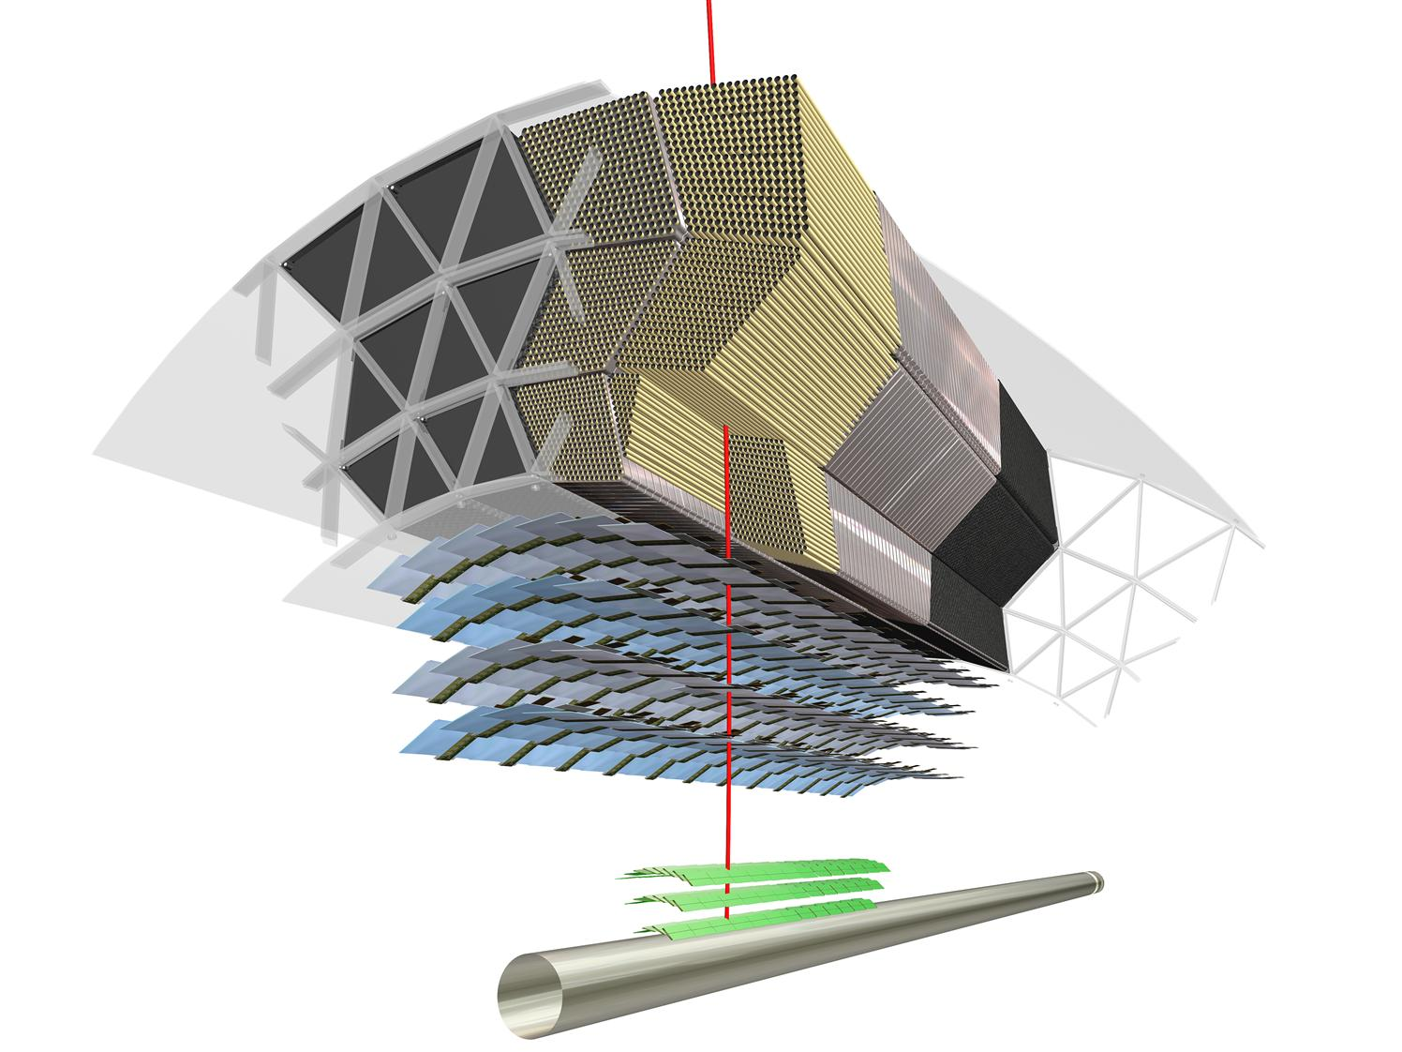

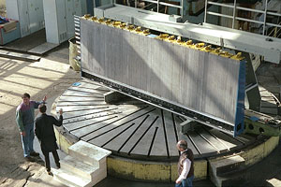
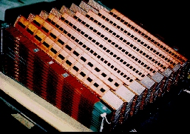
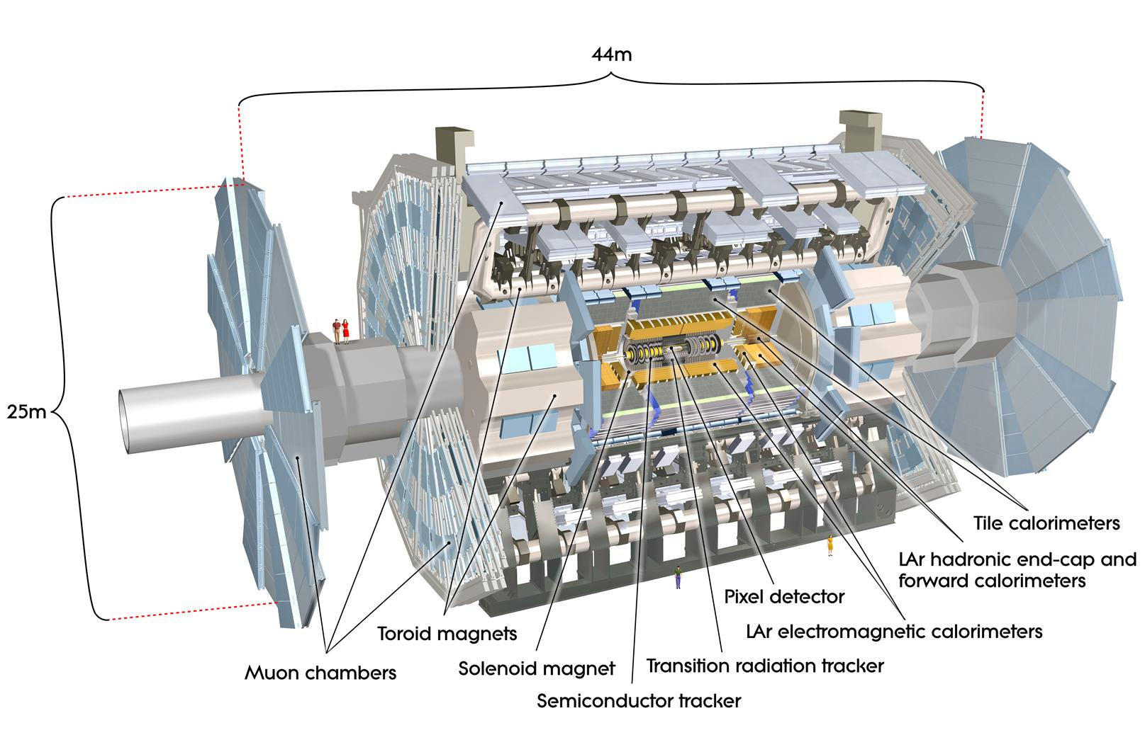
The ATLAS Detector
Large angular coverage:
|η|<4.9; tracking in|η|<2.5
Inner detector: pixels, Si-strips and transition Radiation Tracker in for particle identification
Liquid Argon electromagnetic calorimeter with accordion geometry
Iron-scintillating tile hadronic calorimeter; tiles placed radially and staggered in depth
Toroidal magnetic field (peak 4T) in air-core toroids; 2T in solenoid around Inner Detector

Slide 6
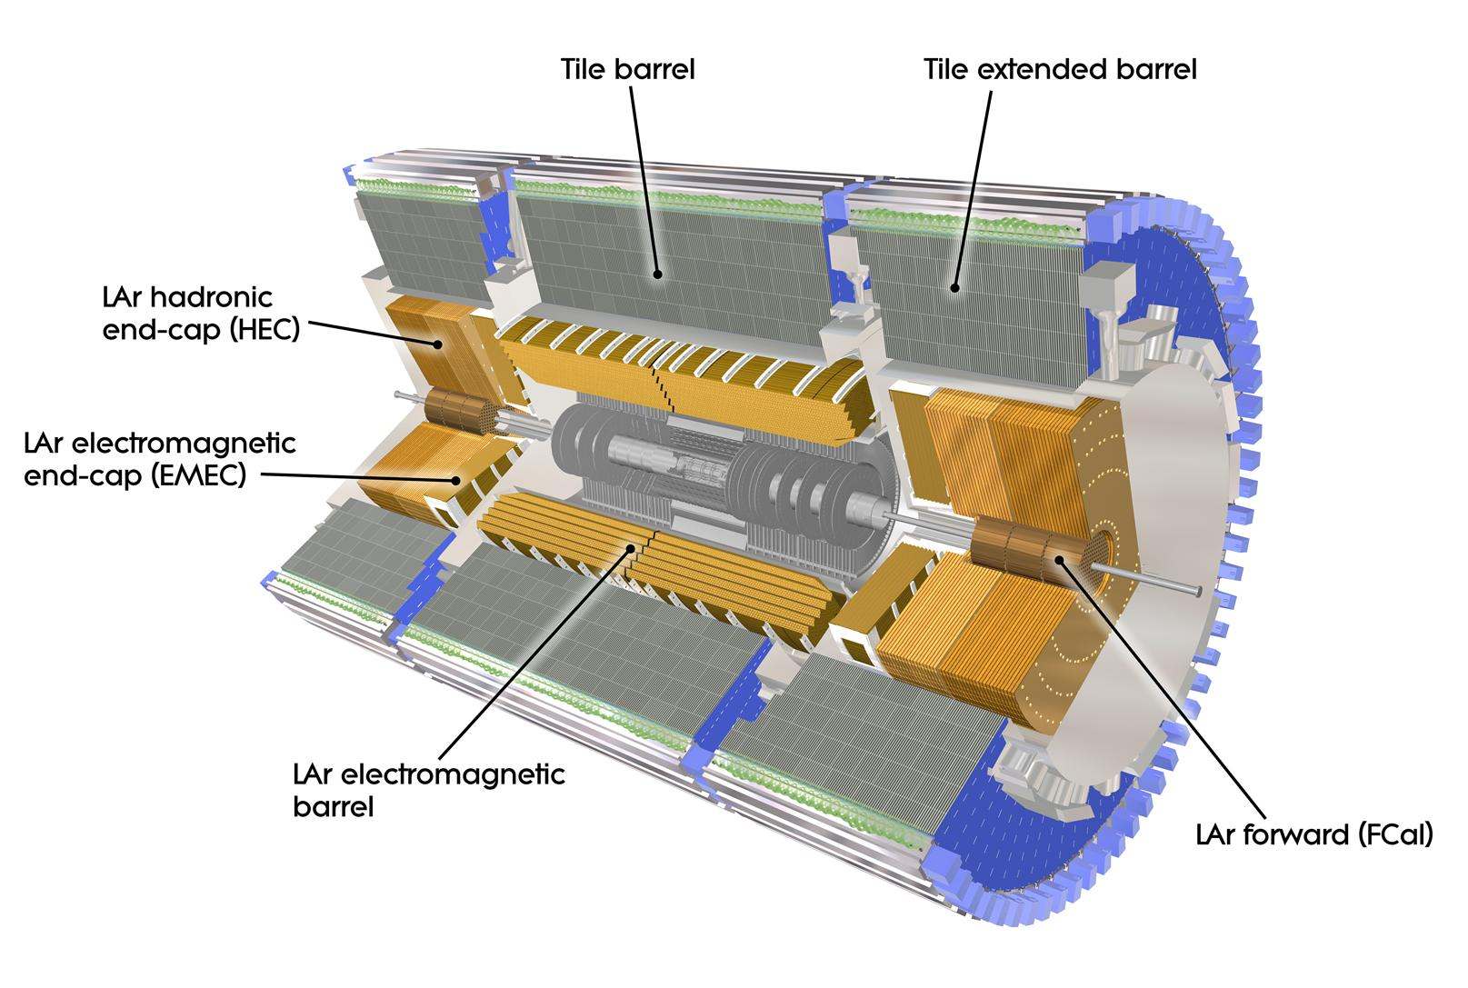
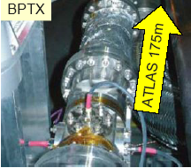
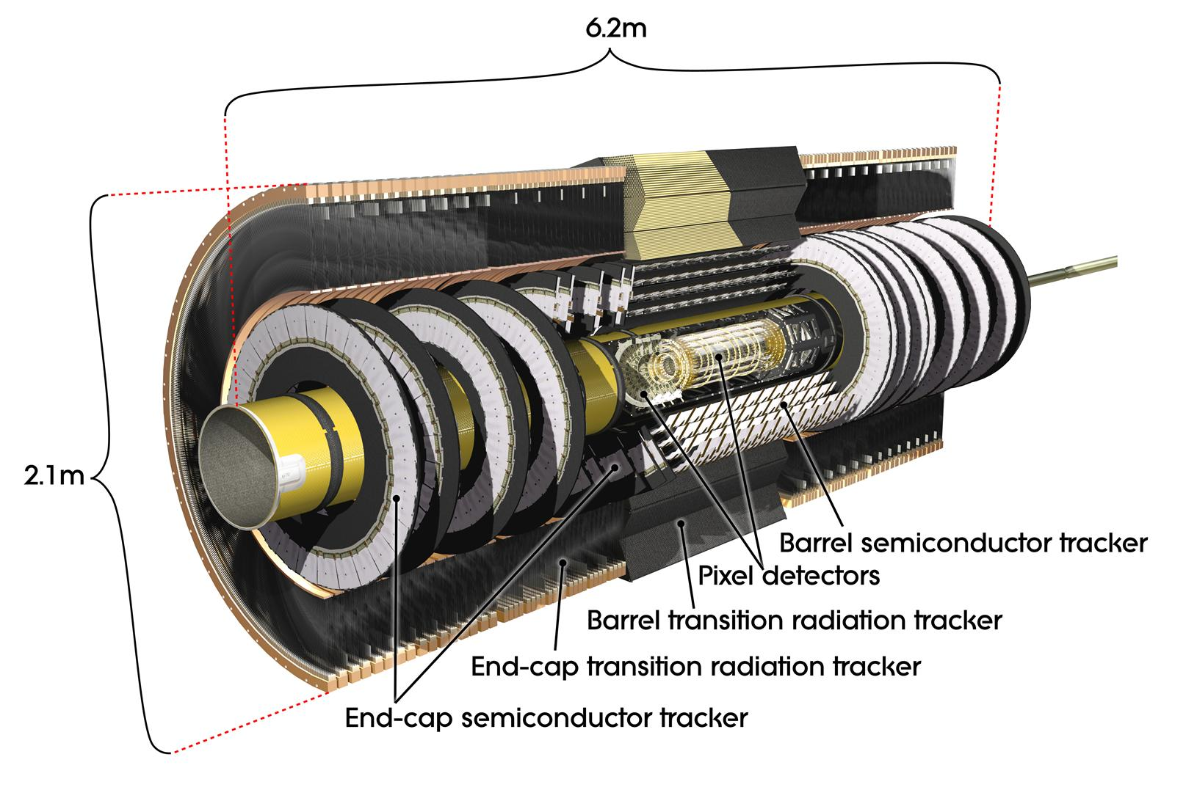
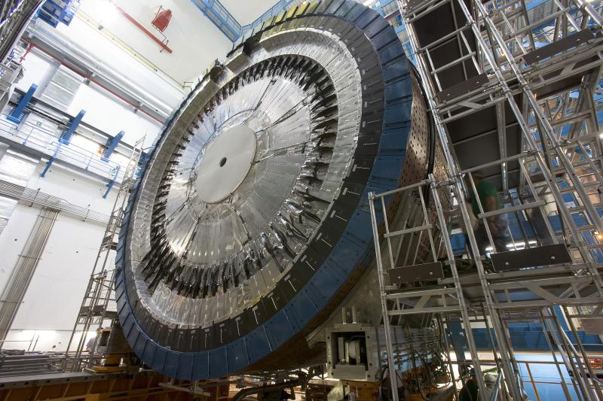
160000 channels
Beam Pickup: at ± 175m from ATLAS
Trigger on filled bunch
Provide the reference timing
Minbias Trigger Scintillator:
32 sectors on LAr cryostat
Main trigger for initial running
η coverage 2.1 to 3.8
Pixel: 10x100μm; 80 M channels
Strips: 80μm; 6 M channels

Slide 7
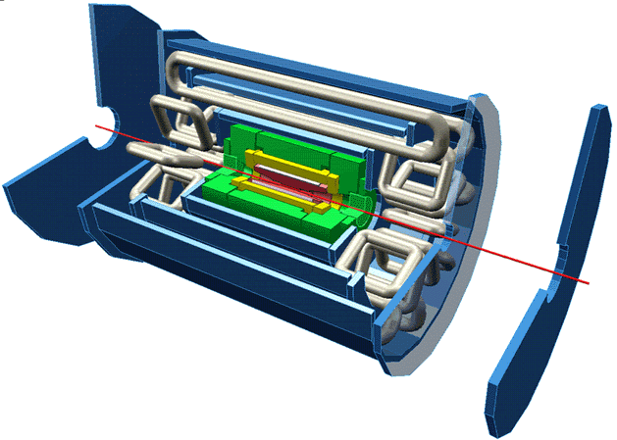
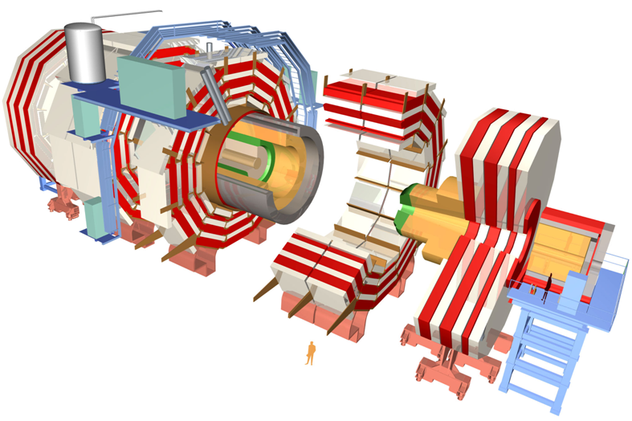
 | ATLAS | CMS
Magnetic field | 2 T solenoid + toroid (0.5 T barrel 1 T endcap) | 4 T solenoid + return yoke
Tracker | Si pixels, strips + TRT σ/p_{T} ≈ 5x10⁻⁴p_{T} + 0.01 | Si pixels, strips σ/p_{T} ≈ 1.5x10⁻⁴p_{T} + 0.005
EM calorimeter | Pb+LAr σ/E ≈ 10%/√E + 0.007 | PbWO4 crystals σ/E ≈ 2-5%/√E + 0.005
Hadronic calorimeter | Fe+scint. / Cu+LAr (10λ) σ/E ≈ 50%/√E + 0.03 GeV | Cu+scintillator (5.8λ + catcher) σ/E ≈ 100%/√E + 0.05 GeV
Muon | σ/p_{T} ≈ 2% @ 50GeV to 10% @ 1TeV (ID+MS) | σ/p_{T} ≈ 1% @ 50GeV to 5% @ 1TeV (ID+MS)
Trigger | L1 + RoI-based HLT (L2+EF) | L1+HLT (L2 + L3)

Slide 8
The ATLAS Trigger

Slide 9
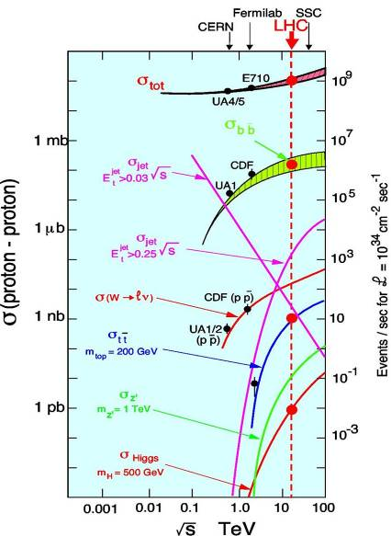
Challenges faced by the ATLAS trigger
Much of ATLAS physics means cross sections at least ~10⁶ times smaller than total cross section
25ns bunch crossing interval (40 MHz)
Event size 1.5 MB (x 40 MHz = 60 TB/s)
Offline storing/processing: ~200 Hz
  ~5 events per million crossings!
In one second at design luminosity:
  40 000 000 bunch crossings
  ~2000 W events
  ~500 Z events
  ~10 top events
  ~0.1 Higgs events?
  200 events written out
We’d like the right 200 events to be written out!...

Slide 10
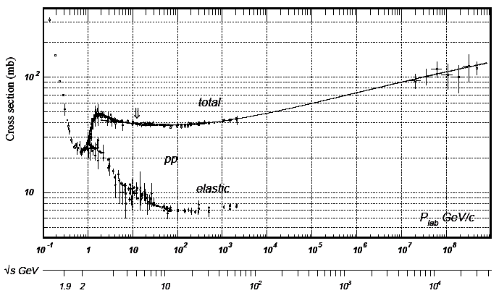
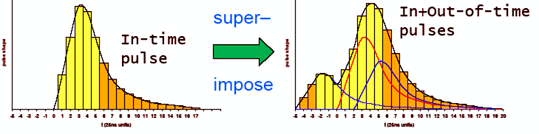
Challenges faced by the ATLAS trigger
L = 10³⁴ cm⁻²s⁻¹ = 10⁷mb⁻¹Hz
σ = 70 mb
=> Rate = 70x10⁷Hz
Δt = 25ns = 25x10⁻⁹ Hz⁻¹
=> Events/25ns = 70x25x10⁻² = 17.5
Not all bunches full (2835/3564)
22 events/crossing
Detector response time varies from a few ns to e.g. ~700 ns for MDT chambers
=> Pileup not only from the same crossing

Slide 11
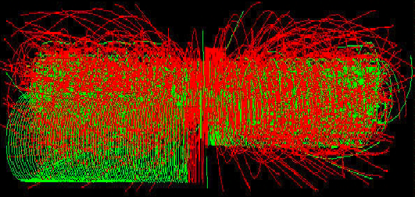
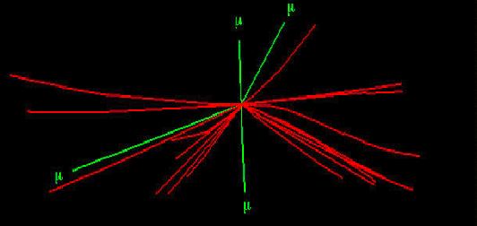
H->4μ

Slide 12
The ATLAS trigger
Three trigger levels:
Level 1:
  Hardware based (FPGA/ASIC)
  Coarse granularity detector data
  Calorimeter and muon spectrometer only
  Latency 2.5 μs (buffer length)
  Output rate ~75 kHz (limit ~100 kHz)
Level 2:
  Software based
  Only detector sub-regions processed (Regions of Interest) seeded by level 1
  Full detector granularity in RoIs
  Fast tracking and calorimetry
  Average execution time ~40 ms
  Output rate ~1 kHz
Event Filter (EF):
  Seeded by level 2
  Full detector granularity
  Potential full event access
  Offline algorithms
  Average execution time ~1 s
  Output rate ~200 Hz
High-Level Trigger

Slide 13
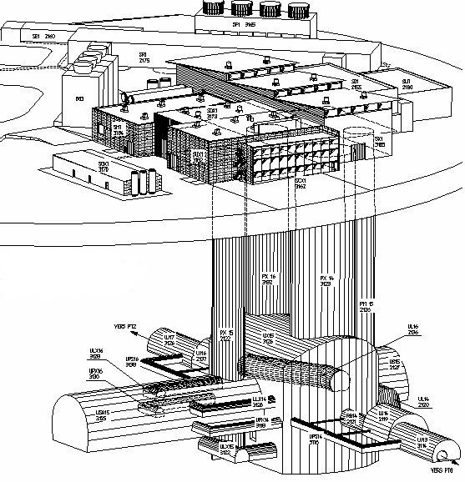
Trigger / DAQ architecture
CERN
computer
centre
4-code dual-socket nodes
6
~1600
~100
~ 500
Event rate
~ 200 Hz
Local
Storage
SubFarm
Outputs
(SFOs)
Event
Filter
(EF)
Event
Builder
SubFarm
Inputs
(SFIs)
LVL2
farm
Second-
level
trigger
Data
storage
DataFlow
Manager
Network
switches
pROS
stores
LVL2
output
Network switches
LVL2
Super-
visor
Gigabit Ethernet
Event data requests
Delete commands
Event data
pulled:
partial events
@ ≤ 100 kHz,
full events
@ ~ 3 kHz
Event size
~1.5MB
Requested event data
Regions Of Interest
Data of events accepted
by first-level trigger
~150
PCs
1600
Read-
Out
Links
VME
Dedicated links
Read-Out
Subsystems
(ROSs)
Read-
Out
Drivers
(RODs)
RoI
Builder
First-
level
trigger
Timing Trigger Control (TTC)
Event data pushed @ ≤ 100 kHz,
1600 fragments of ~ 1 kByte each

Slide 14
First-Level Trigger

Slide 15
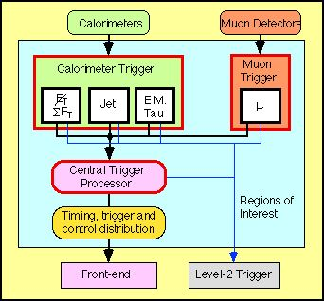
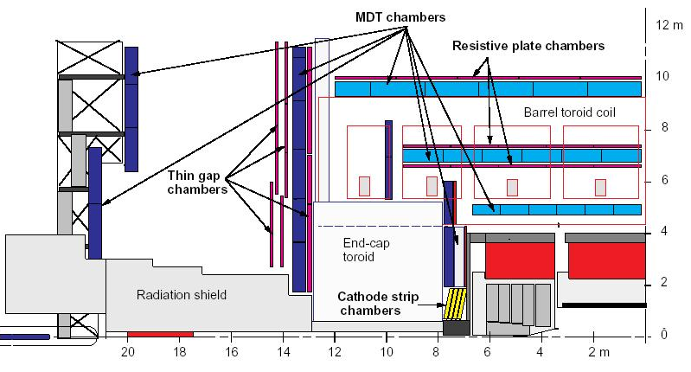
Level 1 architecture
Level 1 uses calorimeter and muon systems only
Muon spectrometer:
  Dedicated (fast) trigger chambers
    Thin Gap Chambers – TGC
    Resistive Plate Chambers – RPC
Calorimeter:
  Based on Trigger Towers: analog sum of calorimeter cells with coarse granularity
  Separate from precision readout
Identify regions of interest (RoI) and classify them as MU, EM/TAU, JET
On L1 accept, pass to level 2:
  RoI type
  E_{T} threshold passed
  Location in η and ϕ
calorimeter

Slide 16
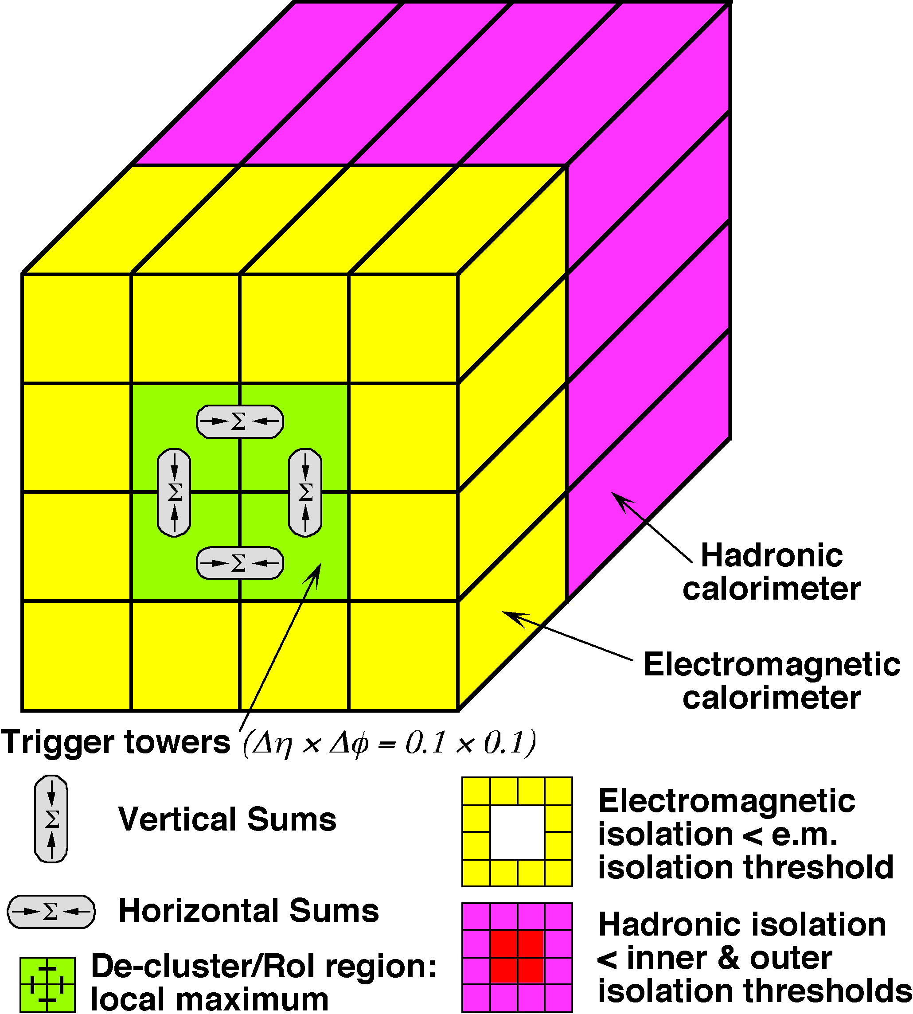
Level 1: Calorimeter Trigger
e/γ trigger
Coarse granularity trigger towers
  Δη×Δϕ = 0.1×0.1 for e, γ, τ up to |η|<2.5
  Δη×Δϕ = 0.2×0.2 for jets, up to |η|<3.2
Search calorimeter for physical objects (sliding window)
  e/γ: isolated electromagnetic clusters
  τ/hadrons: isolated hadronic clusters
  Jets: local E_{T} maximum in programmable 2x2, 3x3 or 4x4 tower sliding window
  Extended to η=4.9 wit low granularity (FCAL)
  ΣE_{T}^{em,had}, ΣE_{T}^{jets} and E_{t}^{miss} with jet granularity, up to η=4.9
Analog sum of calorimeter cells; separate from precision readout
  Separate for EM and hadronic towers

Slide 17
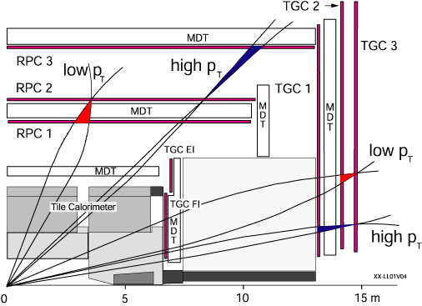
Level 1: Muon trigger
Uses dedicated trigger chambers with fast response (RPC, TGC)
Searches for coincidence hits in different chamber double-layers
  Starting on pivot plan (RPC2, TGC2)
Example:
Low-p_{T} threshold (>6GeV) look for 3 hits out of 4 planes
High-p_{T} threshold (>20GeV) look for 3 hits out of 4 planes + 1 out of 2 in outer layer
Algorithm is programmable and coincidence window is p_{T}-dependent
Toroid

Slide 18
High-Level Trigger

Slide 19
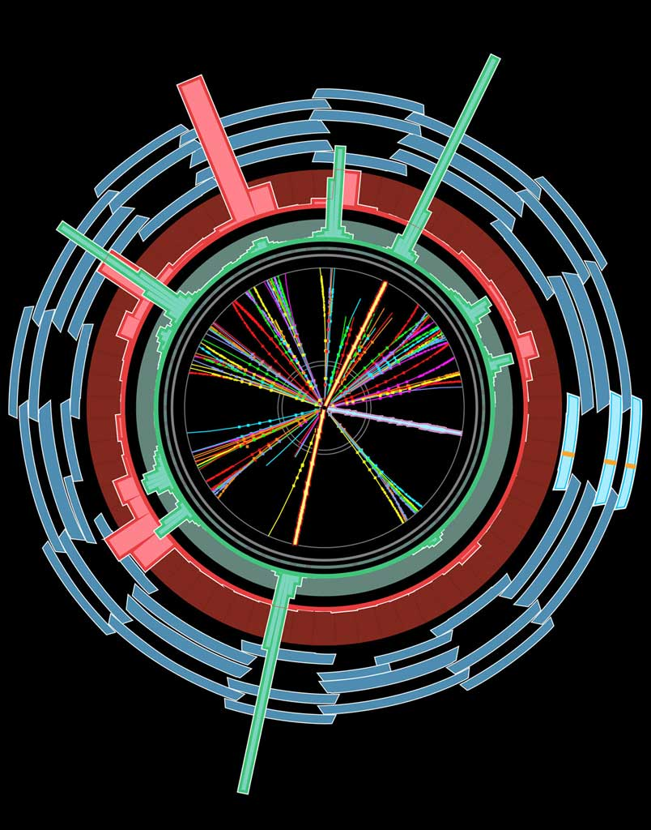
Selection method
Level1 Region of Interest is found and threshold/position in EM calorimeter are passed to Level 2
EMROI
L2 calorim.
Event rejection possible at each step
cluster?
Electromagnetic
clusters
Level 2 seeded by Level 1
Fast reconstruction algorithms
Reconstruction within RoI
L2 tracking
track?
match?
E.F.calorim.
E.F.tracking
Ev.Filter seeded by Level 2
Offline reconstruction algorithms
Refined alignment and calibration
track?
e/γ reconst.
e/γ OK?

Slide 20
High Level Trigger architecture
Basic idea:
Seeded and Stepwise Reconstruction
Regions of Interest (RoI) “seed” trigger reconstruction chains
Reconstruction (“Feature Extraction”) in steps
  One or more algorithms per step
Validate step-by-step in “Hypothesis” algorithms
  Check intermediate signatures
Early rejection: rejects hypotheses as early as possible to save time/resources
Note:
Level 2 usually accesses only a small fraction of the full event (about 2%)
  Depends on number and kind of Level 1 RoI’s
  “Full-scan” is possible but too costly for normal running
Event Filter runs after event building and may analyse full event
  But will normally run in seeded mode, with some exceptions (e.g. E_{T}^{miss} triggers)

Slide 21
Trigger Algorithm Steering
One top algorithm (Steering) manages the HLT algorithms:
  Determines from trigger Menu what chains of algorithms exist
  Instantiates and calls each of the algorithms in the right sequence
  Provides a way (the Navigation) for each algorithm to pass data to the next one in the chain
Feature caching
  Physical objects (tracks etc) are reconstructed once and cached for repeated use
Steering applies prescales
  Take 1 in N accepted events
And passthrough factors
  Take 1 in N events
More technical details:
  Possible to re-run hypothesis algorithms offline – study working point for each trigger
  Possible to re-run prescaled-out chains for accepted events (tricky…for expert studies)

Slide 22
Trigger algorithms
High-Level Trigger algorithms organised in groups (“slices”):
  Minimum bias, e/γ, τ, μ, jets, B physics, B tagging, E_{T}^{miss}, cosmics, plus combined-slice algorithms (e.g. e+E_{t}^{miss})
Level 2 algorithms:
  Fast algorithms – make the best of the available time
  Minimize data access – to save time and minimize network use
Event Filter algorithms:
  Offline reconstruction software wrapped to be run by Steering algorithm in RoI mode
  More precise and much slower than L2
  Optimise re-use and maintenability of reconstruction algorithms
  Ease analysis of trigger data and comparison with offline (same event data model)
  Downside can be a lower flexibility in software development (different set of people/requirements)
Different algorithm instances created for different configurations
  E.g. track reconstruction may be optimized differently for B-tagging and muon finding
All algorithms running in ATLAS software framework ATHENA
  No need to emulate the high-level trigger software
  In development: run MC production from Trigger configuration database
  Only Level 1 needs to be emulated

Slide 23
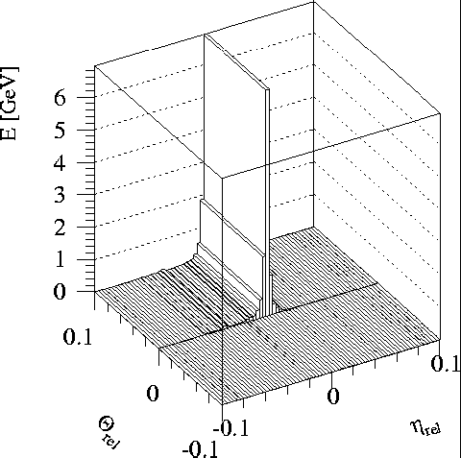
Example: level 2 e/γ calorimeter reconstruction
Full granularity but short time and only rough calibration
Reconstruction steps:
  LAr sample 2; cluster position and size (E in 3x3 cells/E in 7x7 cells)
  LAr sample 1; look for second maxima in strip couples (most likely from π⁰→γγ, etc)
  Total cluster energy measured in all samplings; include calibration
  Longitudinal isolation (leakage into hadronic calorimeter)
Produce a level 2 EM cluster object
π⁰
γ

Slide 24
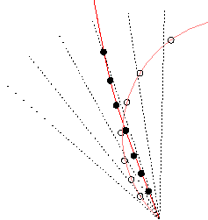
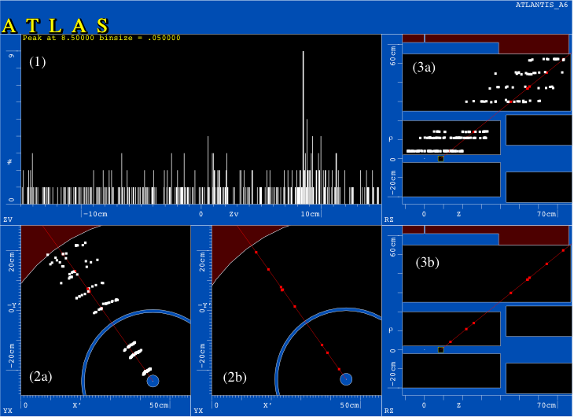
Example: level 2 tracking algorithm
Form pairs of hits in Pixel and SCT in thin φ slices;
  extrapolate inwards to find Z_{vtx} from a 1D histogram
Using Z_{vtx}, make 2D histogram of hits in η-φ plane;
  remove bins with hits in too few layers
Do 2D histogram using space point triplets in 1/p_{T}-φ plane;
  Form tracks from bins with hits in >4 layers
Use Kalman technique on the space points obtained in previous steps
  Start from already estimated parameters: Z_{vtx}, 1/p_{T}, η, φ
Full granularity but short time
Algorithms optimised for execution speed, including data access time
Produce level 2 tracks
ρ
Z
Z
Y
Y
ρ
X
X
Z

Slide 25
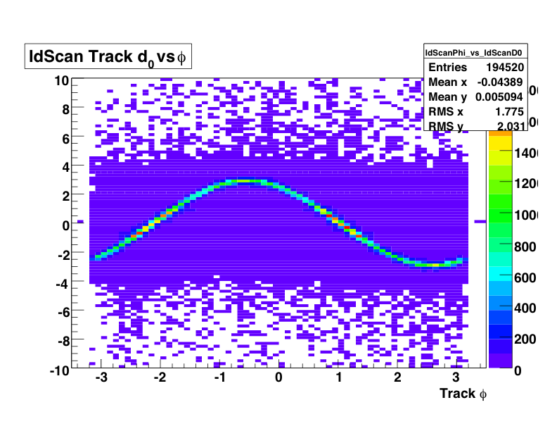
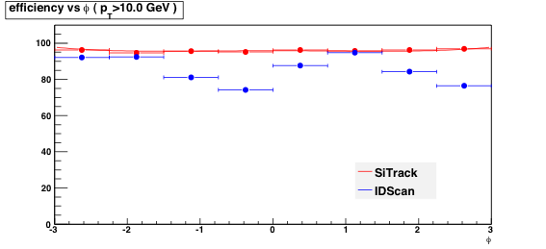
Trigger algorithm robustness
Work has been devoted to verifying that the trigger is robust against several possible error sources
Likely sources of error introduced in simulation:
  Added dead material (up to 1X₀)
  Misaligned inner detector, calorimeter and muon spectrometer
  Displaced beam spot
Example: beam-spot displacement wrt the Atlas reference frame was found to be a possible source of inefficiency
Two aspects:
Tracking algorithm robustness at L2: robust tune found for the L2 tracking algorithms
Online determination of beam-spot position (for B-tagging etc)
Robust tune
Standard tune
φ

Slide 26
Trigger Menu and Configuration

Slide 27
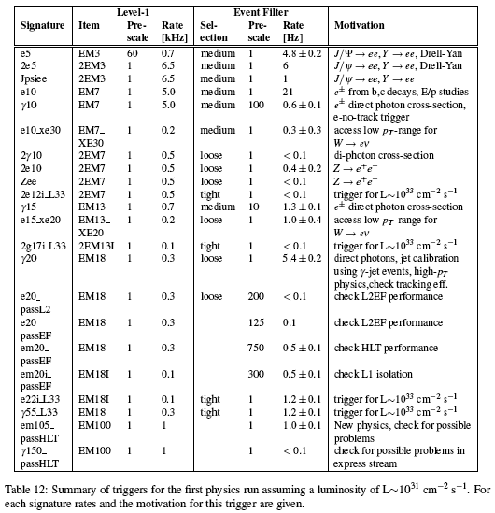
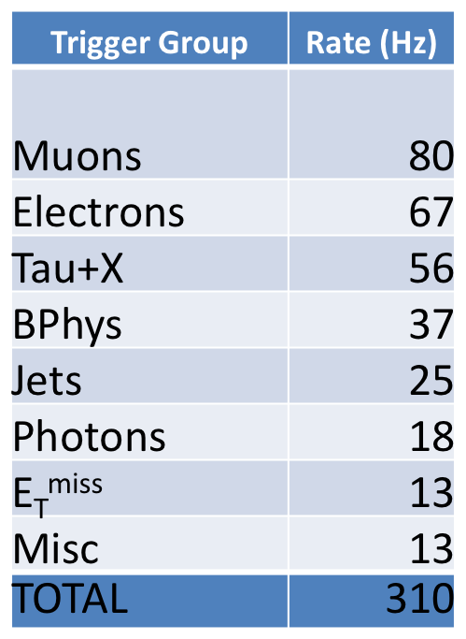
Trigger Menu
Complex menu, includes triggers for:
  Physics
  Detector calibration
  Minimum bias
  Efficiency measurement
Offline data streams based on trigger
Draft e/γ menu for L=10³¹cm⁻²s⁻¹
250Hz plus overlaps

Slide 28
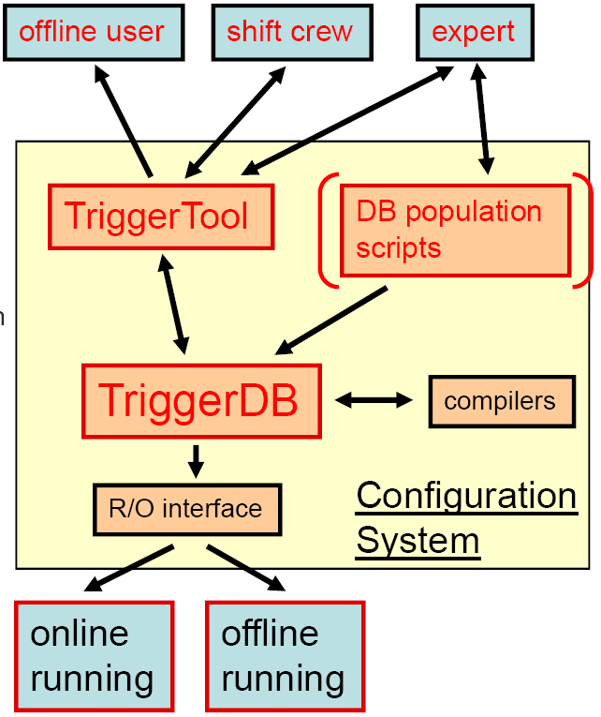
Configuration
Trigger configuration:
  Active triggers
  Their parameters
  Prescale factors
  Passthrough fractions
  Consistent over three trigger levels
Needed for:
  Online running
  Event simulation
  Offline analysis
Relational Database (TriggerDB) for online running
  User interface (TriggerTool)
  Browse trigger list (menu) through key
  Read and write menu into XML format
  Menu consistency checks
After run, configuration becomes conditions data (Conditions Database)
  For use in simulation & analysis

Slide 29
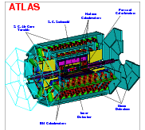
Configuration Data Flow
TriggerDB
All configuration data
Preparation
Configures
Stores
decoded Trigger Menu
Data
taking
Online
Conditions
Database
Encoded trigger decision
(trigger result from all 3 levels )
Decoded Trigger Menu
Trigger Result
passed?, passed through?, prescaled?, last successful step in trigger execution?
Trigger EDM
Trigger objects for trigger selection studies
Trigger Configuration
Trigger names (version), prescales, pass throughs
Data formats:
ESD
Reconstruction/
Trigger aware
analysis
AOD
With decreasing
amount of detail
DPD
TAG

Slide 30
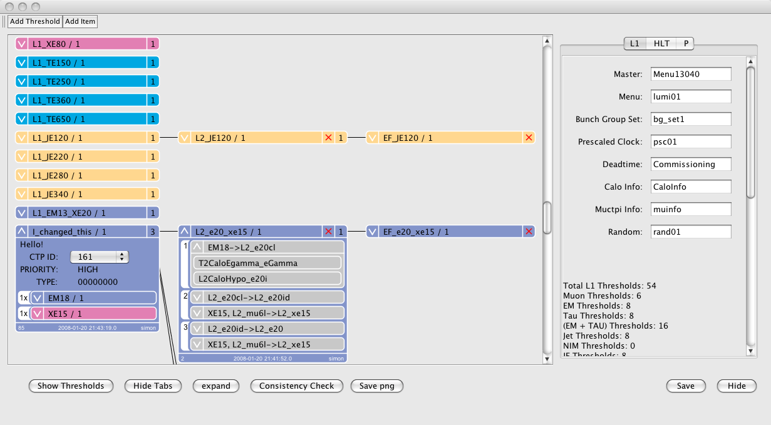
Viewing and Modifying a Menu
L1 Items in menu
L2 chains in menu
EF chains in menu
Record names
Menu can be edited by clicking the object
Some useful statistics
L1 Threshold
Steps
Input / Output Trigger Elements
Algorithms

Slide 31
Performance of the ATLAS Trigger

Slide 32
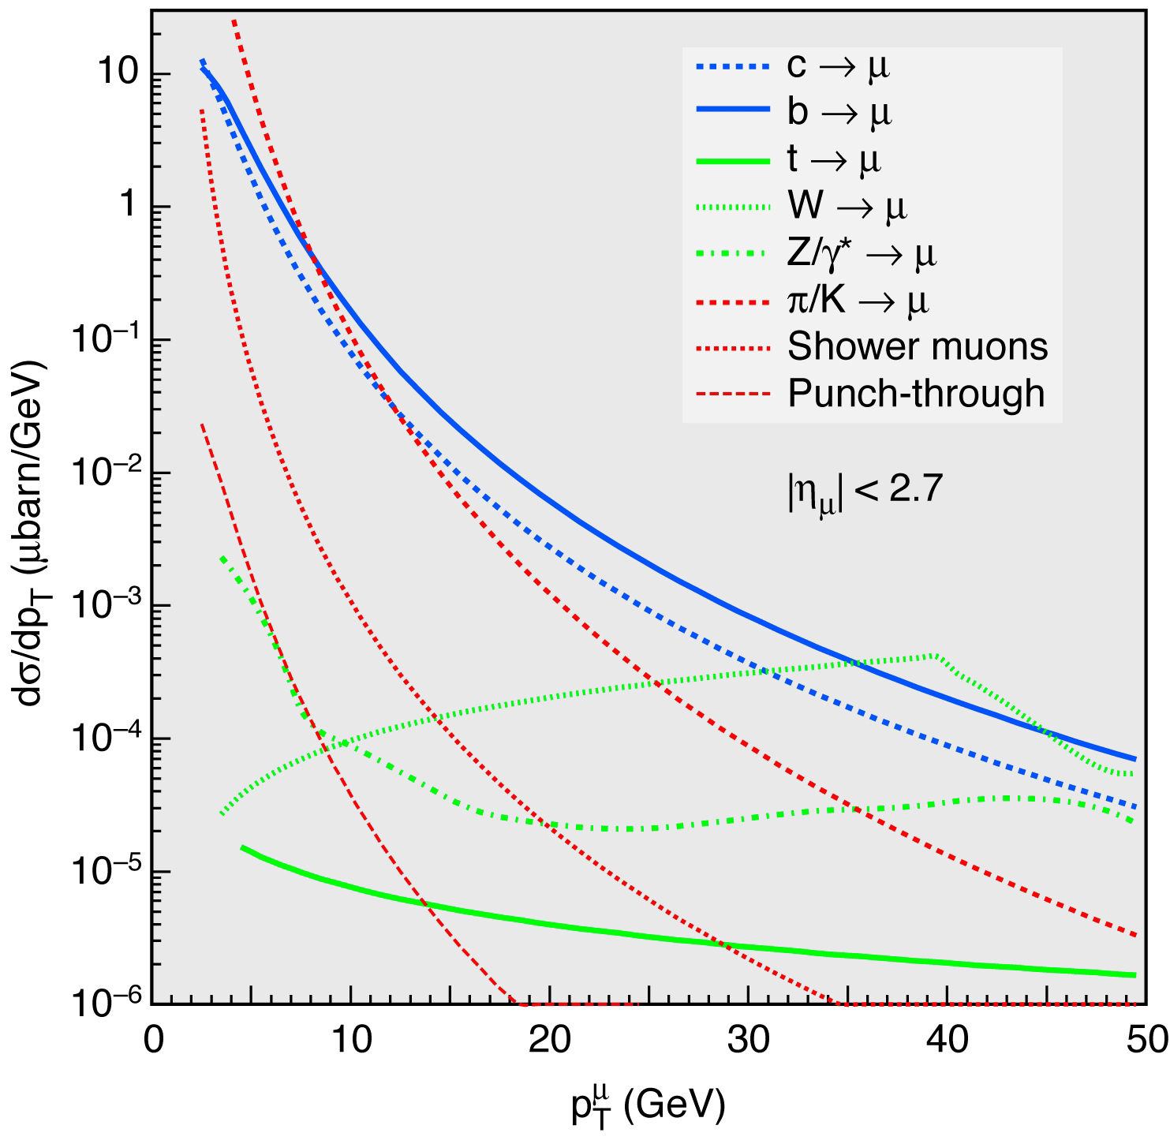
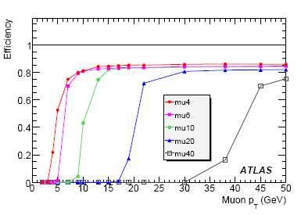
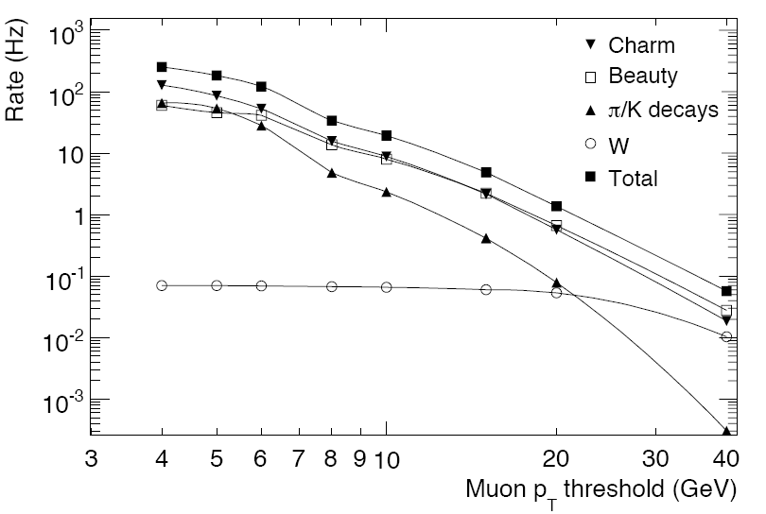
Muon trigger performance
Rapidly falling backgound cross section means a sharp efficiency turn on is essential
Uncertainty in modeling of π, K decays in flight add to rate uncertainty
Absolute efficiency limited by geometrical acceptance (MS feet)
  Efficiency: 80% (barrel), 94% (endcap)
muon inclusive cross sections
L=10³¹ cm⁻²s⁻¹

Slide 33
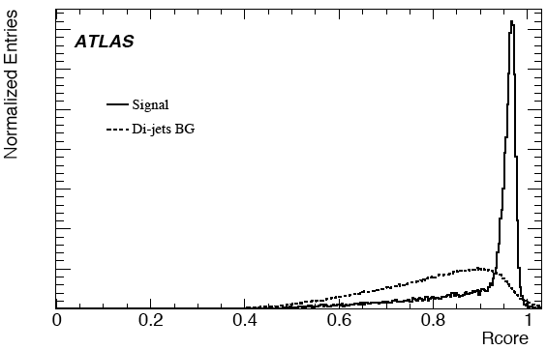
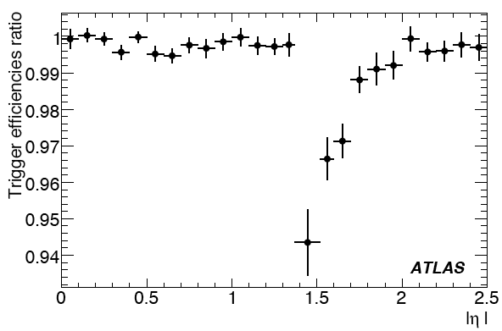
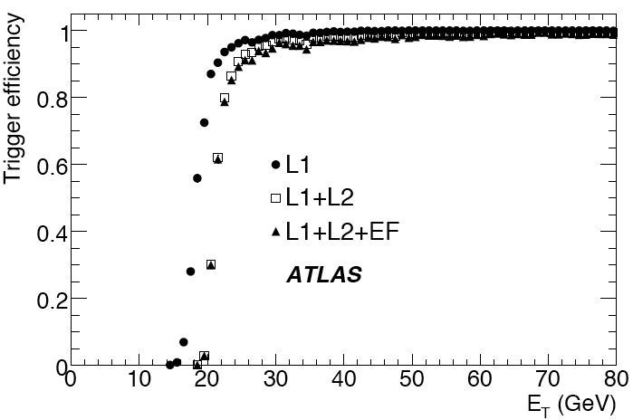
Electron and photon triggers
e/γ triggers use features of LAr calorimeter to calculate discriminating variables (“shower shapes”)
  E.g.: R_{core} = E_{3x7}/E_{7x7} gives width of shower, while accounting for bremstrahlung
Robustness studied in several ways
  Effect of additional inactive material, misalignment, beamspot displacement, pileup
R_{core} = E_{3x7}/E_{7x7}
(cells in sampling 2)
e20: efficiency wrt offline (loose reconstruction)
e10: effect of misaligned detector and inactive material
Fiducial cuts to avoid calo crack

Slide 34
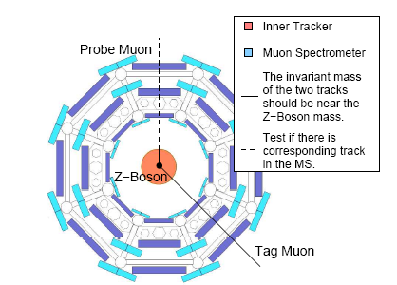
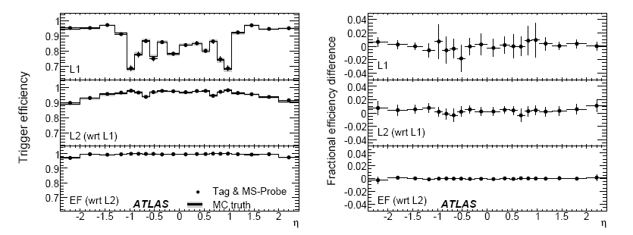
Trigger Efficiency from data
Try to rely on simulated data as little as possible
For electrons and muons the “Tag & Probe” method can be used
  Use clean signal sample (Z, J/ψ → l⁺l⁻)
  Select track that triggered the event (“Tag”)
  Find other track using offline reconstruction (“Probe”)
  Determine efficiency by applying trigger selection to Probe
Applicability of these efficiencies to more busy events also being studied
Z→ μ⁺μ⁻
mu20
Study with ~50 pb⁻¹
Overall efficiency (77.4%±0.4)
Very good agreement between Tag&Probe and MC truth

Slide 35
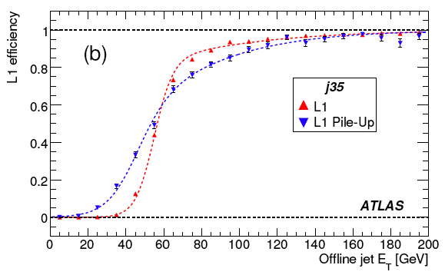
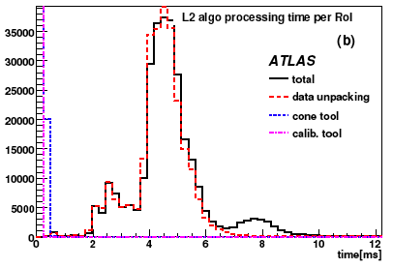
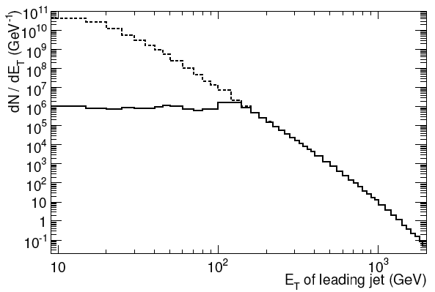
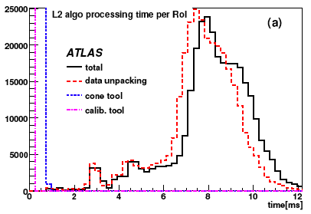
Jet trigger performance
Jet trigger efficiency turn on affected by pileup
Low-E_{T} jet rate too high: prescale low-E_{T} triggers to have constant rave vs E_{T}
Before prescale
After prescale
Level 2: possible to use pre-calculated tower energy components (Ex,Ey,Ez) from front-end boards (FEB)
  Saves unpacking time but has coarser granularity and resolution; studies ongoing

Slide 36
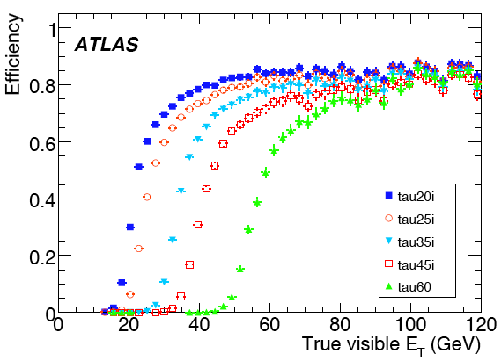
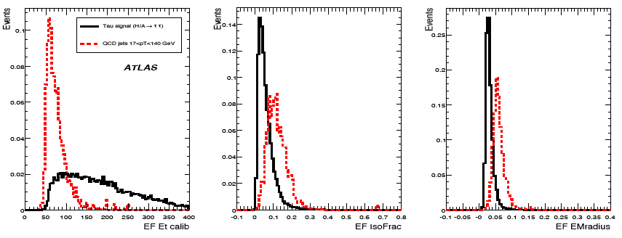
Tau trigger performance
As the electron trigger, taus rely on shower shapes in the calorimeter and finding a number of matching tracks
Turn on curve dominated by the level 1 energy resolution
At the Event Filter, offline reconstruction is used
  Track-initiated tau identification to complement an older calorimeter-initiated algorithm

Slide 37
Commissioning the ATLAS Trigger

Slide 38
Timeline
Commissioning has been going on for more than a year with a gradually more complete system
The TDAQ system (but not Level 1) was exercised in “Technical runs”
  Learned how to deal with a large HLT farm
  Correct estimates of processing time
  Helped develop configuration and monitoring tools
Cosmics runs use Level 1 and detectors
  Need special menu: triggers that are efficient in selecting cosmic ray events
  Very hard to test physics triggers meaningfully
  Can collect charged tracks useful e.g. to constrain some detector alignment degrees of freedom
Single beam:
  Allowed to time-in some detectors: properly assign detector signals to bunch-crossing
  Started to find dead channels, correlate problems between detectors etc
“Technical runs” test TDAQ system, no detectors
“Cosmicsl runs” test the whole system
Single beams: systems time-in, etc
Back to cosmics…
periodically
10-12 Sept.08
LHC accident
until Nov.08

Slide 39

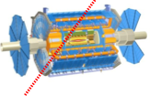
Technical and cosmics runs
Technical runs
Cosmics runs
Monte Carlo Events
Cosmic Real Events
Playback mode
Real mode
Level 1
Data is pre-loaded into the Read Out System
DAQ/HLT plays back the data through the whole system except Level 1
Allows testing the system in realistic environment
Real data comes from the detectors
Allows testing the whole system including Level 1
Tests the software with real “imperfect” data
Limited to cosmic-ray events
Level 2
Event Filter
Mass
Storage

Slide 40
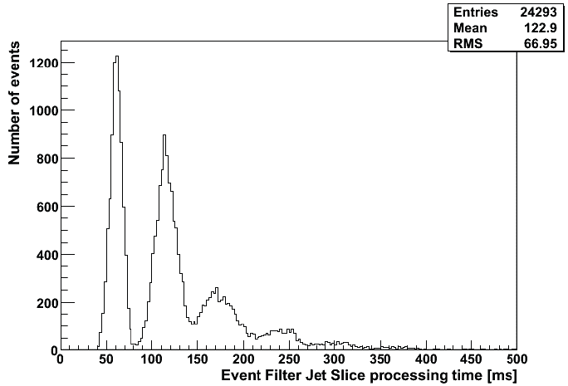
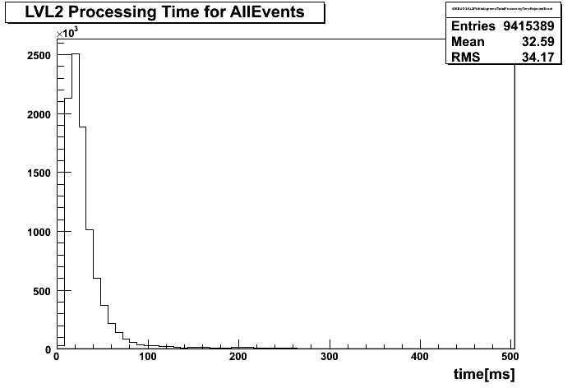


MC Event playback
Number of RoIs
<L2 Time> = 33 ms
Very useful to test system and estimate e.g. processing time
10³¹ trigger menu on L1-accepted minimum bias sample:
  33 ms @ L2 (40 ms nominal)
  142 ms @ EF (1 s nominal)
Algorithm timing
Study: prescales applied before/after each level
  Gains for early prescaling, but menu dependent
<EF Time> = 142 ms

Slide 41



First experience with LHC beams
LHC beam
loss monitor
tertiary
collimators
140 m
BPTX
175 m
ATLAS was ready for first beam:
LHC start-up:
Muon system (MDT, RPC, TGC) on at reduced HV
LAr (-FCAL HV), Tile on
TRT on, SCT reduced HV, Pixel off
BCM, LUCID, MinBias Scintillators (MBTS), Beam pickups (BPTX)
L1 trigger processor, DAQ up and running, HLT available (but used for streaming only)
Go step-by-step, stopping beam on collimators, re-align with centre
Open collimator, keep going
Last collimator before beam through ATLAS – tertiary collimators (protection of triplets)
Splash event from these collimators for each beam shot with collimator closed

Slide 42




Atlas relied on the MBTS and the L1 calorimeter triggers to record the first events
Later used BPTX (beam pickup) as timing reference
Defines time when bunch crosses interaction point
Used this to adjust time of other detectors
  See TGC time difference as beam crosses detector
BPTX
MBTS
Debunching: last 2 turns seen by MBTS, not seen by BPTX
Long fill seen by the BPTX

Slide 43




Cosmic run after LHC incident
Combined cosmic run (all sub-detectors) from 17th September to 23rd October
Aim was to debug the system further and to calorimeter signals and muon tracks for alignment and calibration
HLT running in “flagging mode” used only to send events to streams, but this allowed plenty of validation
Also did high-rate tests of Level 1 and HLT with good results
Level 1 calorimeter E_{T} (x) vs offline E_{T} (y)
TGC
Stream

Slide 44



X-ray of the ATLAS cavern with cosmic muons
Elevators
Access shafts
Very good correlation between
RPC (trigger chambers) and
MDT (precision chambers) hits

Slide 45
Conclusions

Slide 46


Conclusions
The ATLAS Trigger is now mature:
Both level 1 and the High Level Trigger used with real data from the LHC and with cosmic rays
Important progress was made!
Plans for this year:
Trigger workshop in February:
  Review the 2008 run: what went wrong? What went right? What do we need to change for the next run period?
  Plan ahead for 2009: trigger menu; monitoring; data quality; physics analysis support; configuration…
Start taking cosmics early before new run starts
Eagerly awaiting LHC data later this year!
A cosmic
event with
field on seen
in TRT

Slide 47

The first has been delivered to the CCC
Delivered!
2009

