Slide 1
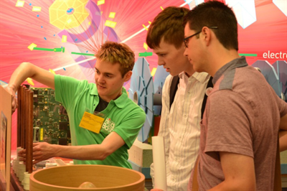
Rob Cantrill
New postdoc, started at LIP yesterday
Comes from Royal Holloway and ATLAS member
Worked on H➔γγ (Vector Boson Fusion) for his thesis
Will work on ttH project and on Jet trigger

