Slide 1


Trigger Tools for Physics Analysis
  Some use cases
  Building a data sample
  Event by event analysis
  Input from across the Atlantic
  conclusions
Thank you! Michael Begel, Gustaaf Brooijmans, Tomasz Bold, Till Eifert, Sinead Farringdon, Teresa Fonseca, Simon George, Rasmus Mackeprang, Srini Rajagopalan, Joerg Stelzer, et al.

Slide 2
Use cases
Data selection and normalization
Tag and probe
Trigger efficiency correction
Menu for Monte Carlo generation

Slide 3
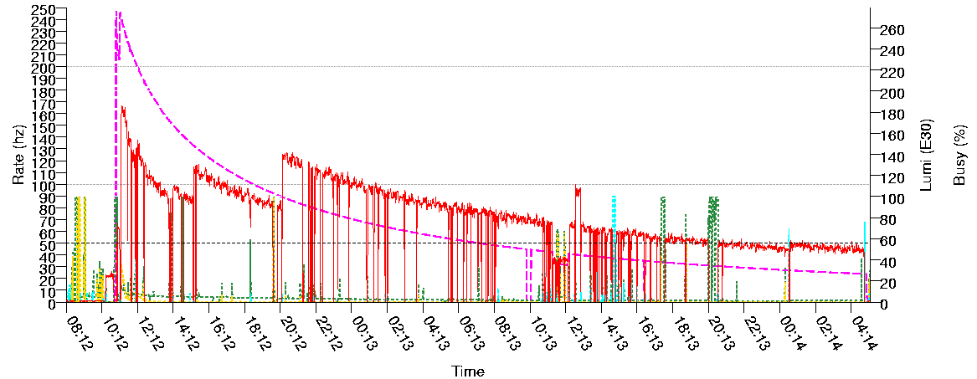
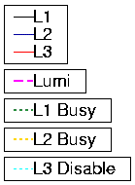
Selecting and normalising a data set
Analysis may rely on a specific trigger or group of triggers (OR) to select events
Trigger decision used to stream events
Tag database can be used to build up dataset based on trigger decision
Normalising a dataset:
  Need to either take the trigger efficiency into account
  Or guarantee that the trigger efficiency with respect to the offline selection is ≈100%
  Efficiency of prescaled trigger needs further correction
  Prescale factor may change frequently – constant for each luminosity block
    too frequent changes should probably be limited, at least in the beginning
  The situation becomes more complicated for an OR of several prescaled triggers…
  Similar issues in other experiments, but with prescale periods longer than luminosity blocks

Slide 4
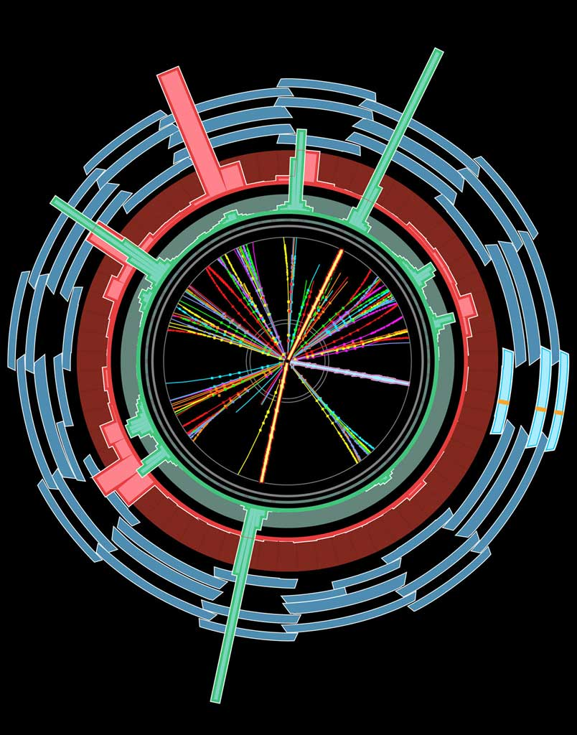
Tag and probe
Tag & Probe:
Selected events with single-lepton trigger
Offline: select Z->l⁺l⁻ events
  Reconstruct >=2 leptons
  Apply m_{Z} and fiducial cuts etc
Match one of the 2 leptons with a trigger lepton passing single trigger
Search for second matching trigger lepton
Count successes in 2nd matching
e20i
?
Need to be able to match offline objects with online objects:
Minimal info needed is RoI η and φ
Better matching would need trigger objects (muon hits, perigee, etc)
M_{Z}

Slide 5
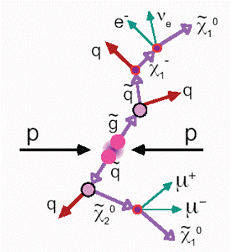
Another example (artificial?... not so much)
Χ₂⁰ cross section:
  σ = (N_{obs}-N_{bkg})/(A ε_{trig} ε_{off} L)
  Trigger and offline muon efficiency determined per initial muon (tag&probe)
  Select events with >= 2 μ to increase stats
  Find μμ pair in one side of event and identify X₂⁰
  Correct trigger efficiency ε_{trig} for events with 3 muons
Needs to match trigger and offline objects to avoid miscalculation
μ

Slide 6
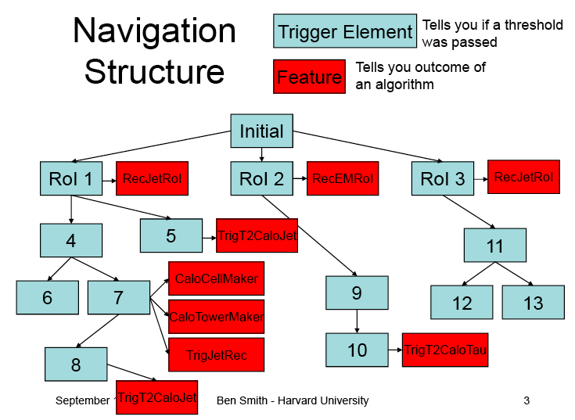
Trigger Navigation
Trigger event processing coded into navigation tree: chains, sequences, trigger elements – navigation is ‘snapshot’ of event at end of trigger processing
Data produced during trigger processing (“features”) attached to nodes of navigation tree (“trigger elements”)
Navigation tree and features stored in HLTResult objects (into ESD, AOD, DPD)
Allows to “navigate” to data produced somewhere in trigger chain

Slide 7
Menus for Monte Carlo generation
Related issue:
  What trigger menu to use when generating MC samples?
    What menu composition?
    What prescale set?
For MC samples to be compared with data in store:
  Menu composition determined by triggers active during running period
  Prescale set:
    May be possible to determine an average prescale factor, p, for each trigger
      Prescale per lumi block, p_{i} , weighted according to integrated luminosity per block L_{i}
      Assumes instantaneous luminosity doesn’t change by a huge factor
    Otherwise need to divide sample into smaller chunks according to instantaneous luminosity?

Slide 8
Building a data sample
Data quality
Trigger configuration
Luminosity and prescales

Slide 9
Need to know…
Data quality check:
  Use data quality flags
  Different analysis will need different parts of detector active and working well
Configuration: necessary trigger/set of triggers active in the menu
  Determines which stream to run on
  And with convenient configuration – selection cuts consistent with offline analysis cuts
  Efficiency (Is it adequate to the analysis? Object based/simulation?)
  Prescale factors (Fixed? Changing?)
Integrated luminosity: how much in selected runs?
  To normalise distributions and compare with MC
  To calculate cross sections

Slide 10
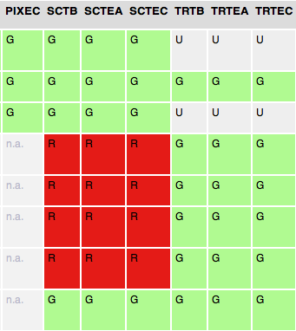
Data quality flags
Red: bad
Green: good
Yellow: partially bad, some channels missing, hole in calo, etc
Black: disabled, not in partition
White: in partition
Grey: or blue, undefined, tried to check quality but couldn’t
Filled by online shifter, automatically by DQMF, verified by offline shifter
  Stored in COOL per lumi block
  Analysed in user analysis jobs, DPD making, etc
Flags have several states
  Red, Green, Yellow, Black, White
Expected in trigger (ongoing):
  one flag per slice
  one flag per detector system
  one for L1Calo, L1 muon
  Should be possible to run job on:
    Physics.egamma stream
    From run X to run Y
    Requiring e.g. Pixel, SCT and TRT >=yellow

Slide 11
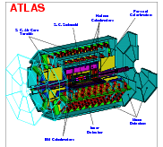
Configuration Data Flow
TriggerDB
All configuration data
Preparation
Configures
Stores
decoded Trigger Menu
Data
taking
COOL
Encoded trigger decision
(trigger result from all 3 levels )
Decoded Trigger Menu
Trigger Result
passed?, passed through?, prescaled?, last successful step in trigger execution?
Trigger EDM
Trigger objects for trigger selection studies
Trigger Configuration
Trigger names (version), prescales, pass throughs
Data formats:
ESD
Reconstruction/
Trigger aware
analysis
AOD
With decreasing
amount of detail
DPD
TAG

Slide 12
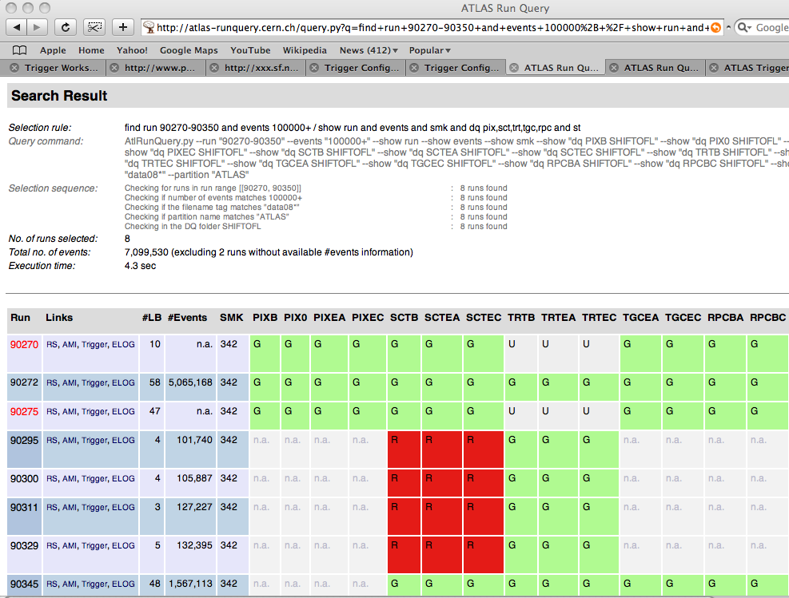

Examine runs, streams, DQ, trigger SMK, etc: http://atlas-runquery.cern.ch/

Slide 13
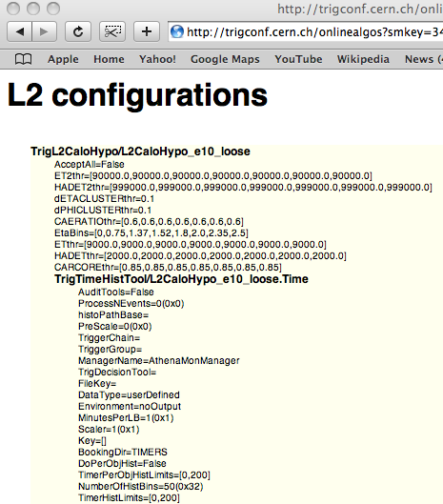
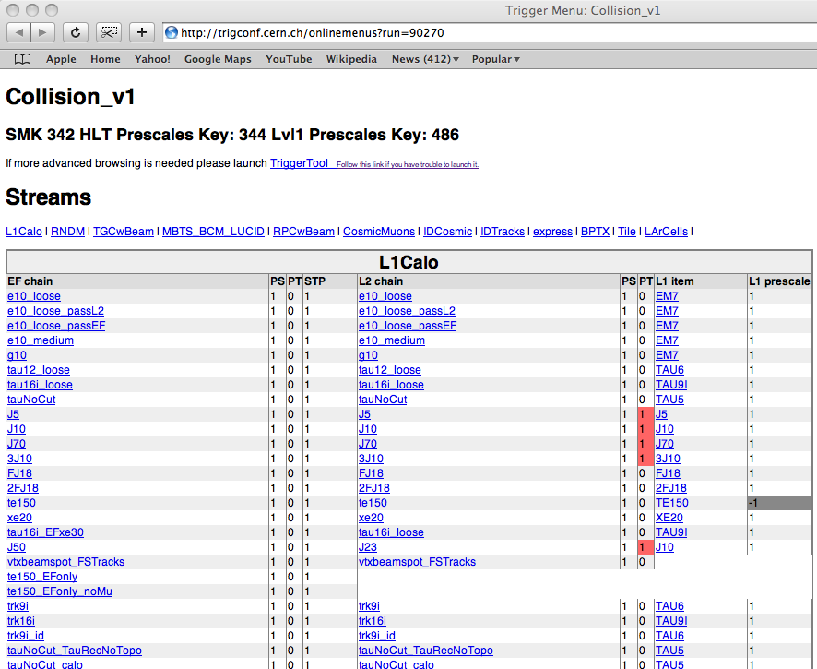
Allows to browse the trigger menu used in that run
Can now go down to the level of individual properties of e.g. Hypo algorithms

Slide 14
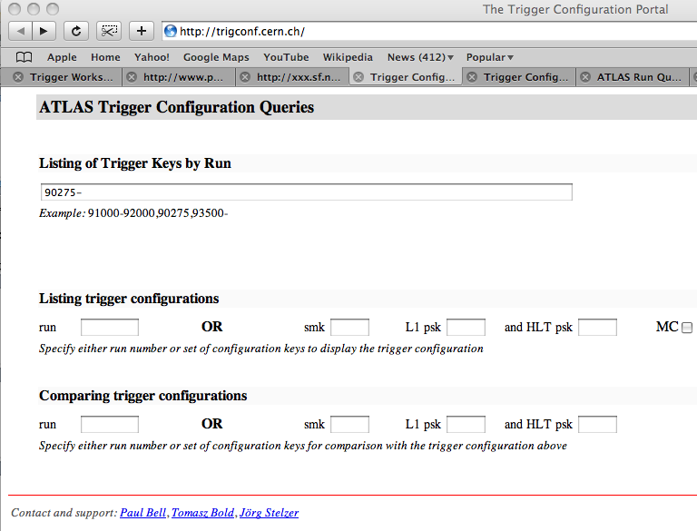
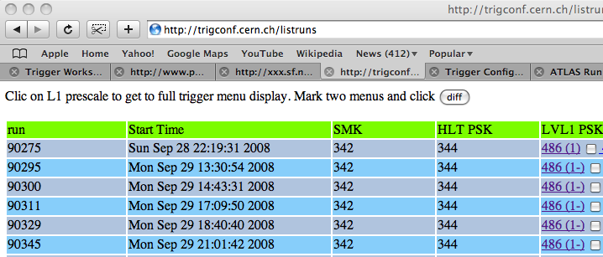
Browse trigger configuration database: http://trigconf.cern.ch/
Allows to see the difference between 2 menus
✓
✓

Slide 15
Infrastructure for efficiency distribution
See talks by Corrine Mills and Matthias Schott
Can provide a common way to apply trigger efficiencies to user analyses
Sample
Selection
Efficiency
Measurement
End User
(evt. effs)
DATABASE
DPD
(four-vectors)
ε(p_{T},η,ϕ…)
(root files)

Slide 16
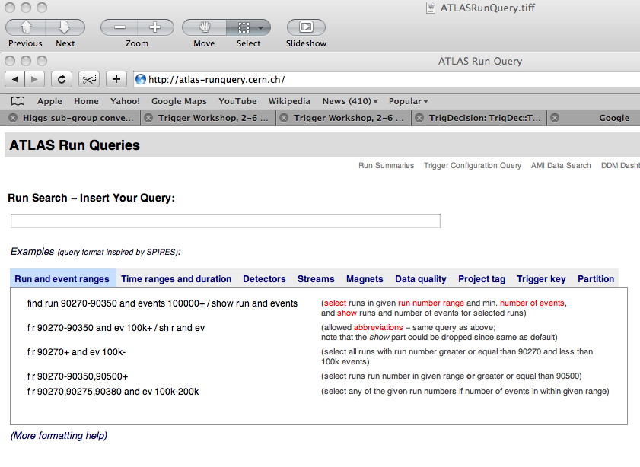
Fictional tool! Under development
f r 90270-90350 and dq em y+ and dq and tr e20i / sh dq pix,sct,em,til, lumi
Lumi

Slide 17
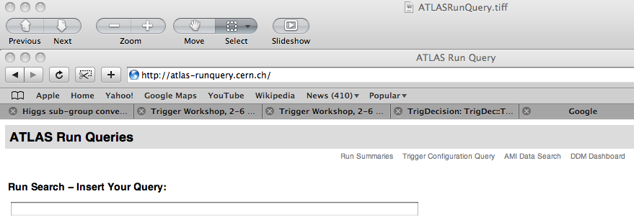
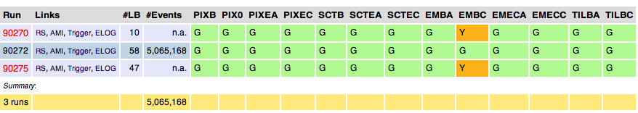
Fictional tool! Under development
f r 90270-90350 and dq em y+ and dq and tr e10i / sh dq pix,sct,em,til, lumi
Lumi (pb⁻¹)
429
2051
1892
4372 pb⁻¹
Should be able to accept groups of triggers to be OR’ed (but need to be careful with this feature)
Should give the run’s integrated luminosity corrected by the prescale factor
Perhaps it could also return the prescale factor weighted by luminosity

Slide 18
Event-by-event analysis
TrigDecisionTool
TriggerARA
New TrigDecisionTool interface

Slide 19
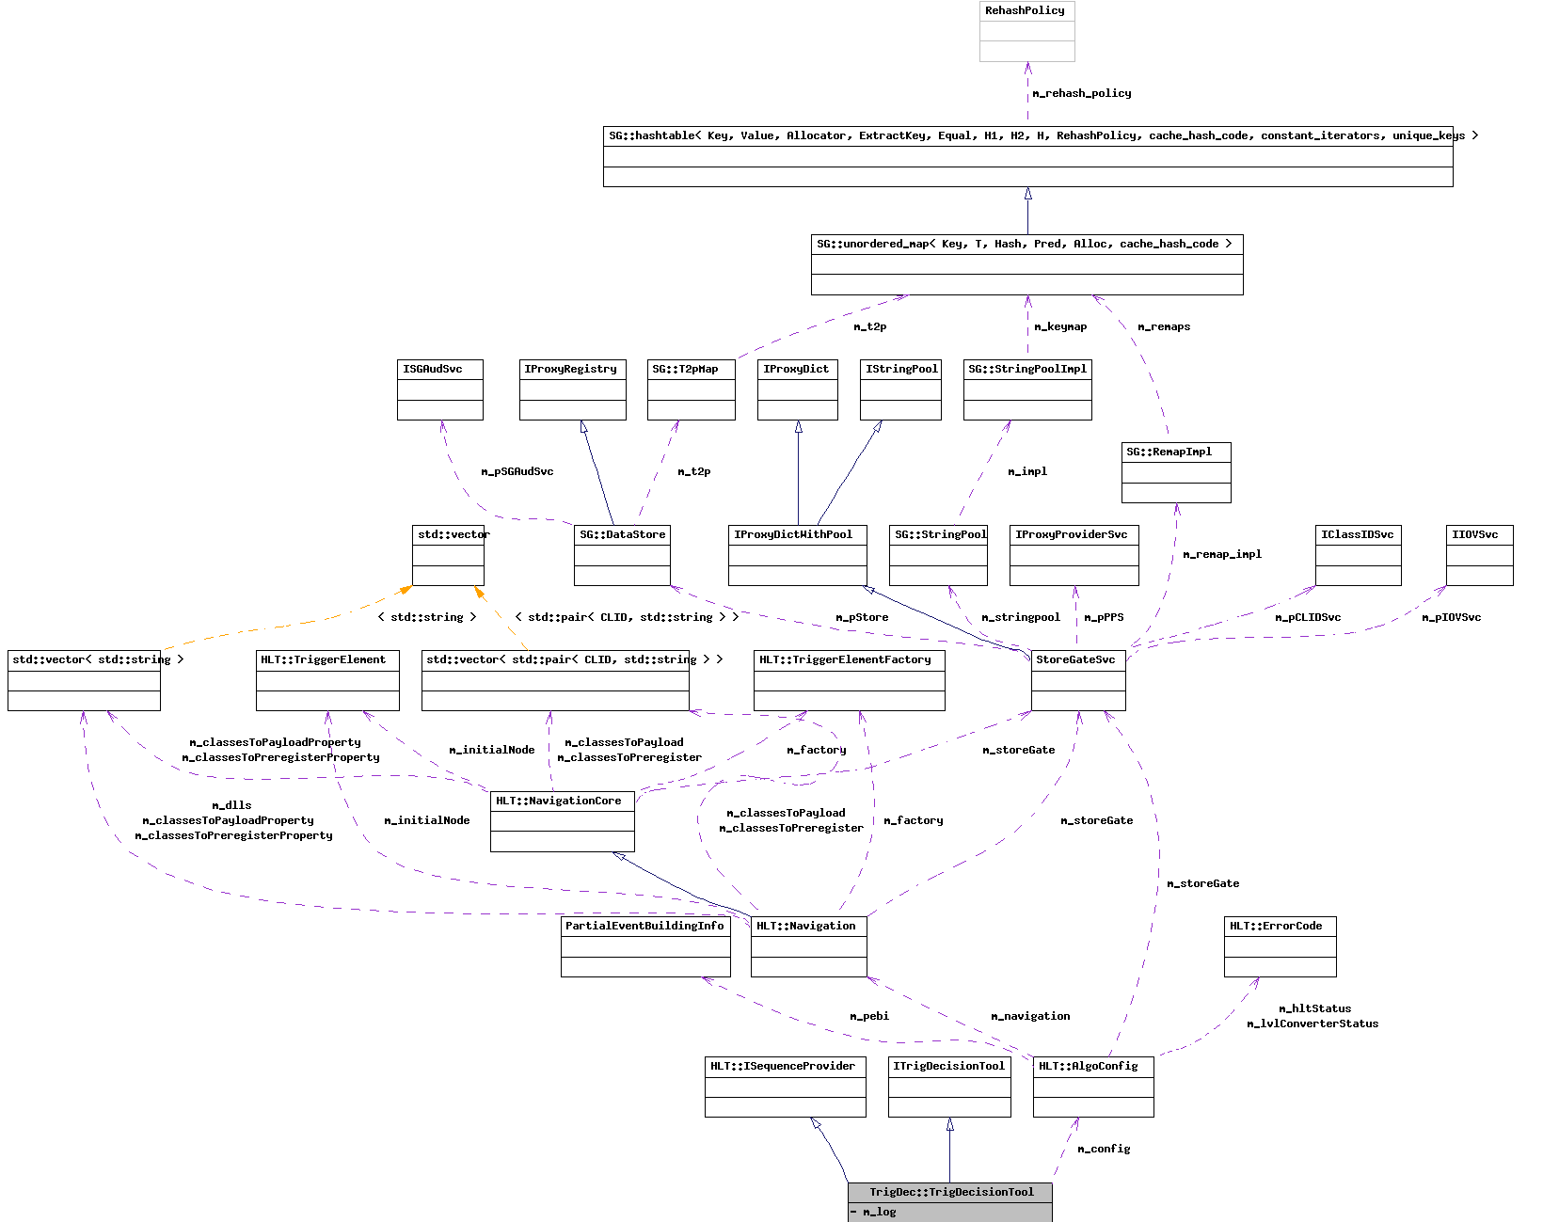
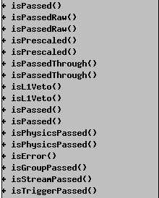
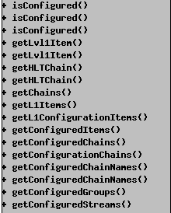
TrigDecisionTool
The TrigDecisionTool is our main interface to trigger data
  Well known of the physics community by now
  Allows to find pass/fail status of each trigger
  Provides user interface to navigation
Allows checking configuration information interactively
Practicals:
  Use isPhysicsPassed() , not isPassed()
    Excludes events passed only by passthrough factors
  Can retrieve TrigElectronContainer, but not TrigElectrons – mostly an exception

Slide 20
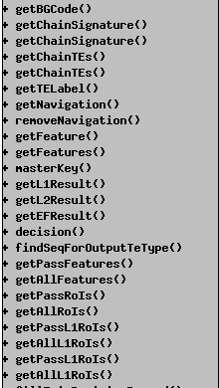
TrigDecisionTool has a few problems: complexity, robustness, etc; not really a user-friendly tool – being re-written
See:https://twiki.cern.ch/twiki/bin/view/Atlas/TrigDecisionTool14
Separate tool to work in ARA – only Python, no c++ version (under development)
See: https://twiki.cern.ch/twiki/bin/view/Atlas/TriggerARA14
and an example: http://atlas-sw.cern.ch/cgi-bin/viewcvs-atlas.cgi/groups/Arizona/ARATopAnalysis/src/TrigStudy.cxx?revision=1.1&view=markup
New interface: TrigDecisionTool is being re-written as a dual-use tool – same usage in Athena and in ARA (M.Begel, C.Hensel)
See: https://twiki.cern.ch/twiki/bin/view/Atlas/NewTrigDecisionToolInterface
std::vector<const TrigTauCluster* > vec_tauClust;
errCode = m_trigDec->getPassFeatures("L2_tau16i”, vec_tauClust);
if (errCode == HLT::OK) {
std::vector<const TrigTauCluster* >::const_iterator CI = vec_tauClust.begin();
for(;CI != vec_tauClust.end(); ++CI) {
(*m_log) << MSG::INFO << "REGTEST ” <<" Energy in EB sampling 1: ”
<< (*CI)->energy(CaloSampling::EMB1)
<<" Energy in EB sampling 2: "<<(*CI)->energy(CaloSampling::EMB2)
<<" Energy in EB sampling 3: "<<(*CI)->energy(CaloSampling::EMB3)
<<endreq;
}

Slide 21
Ideas from across the sea
Information pages from D0

Slide 22
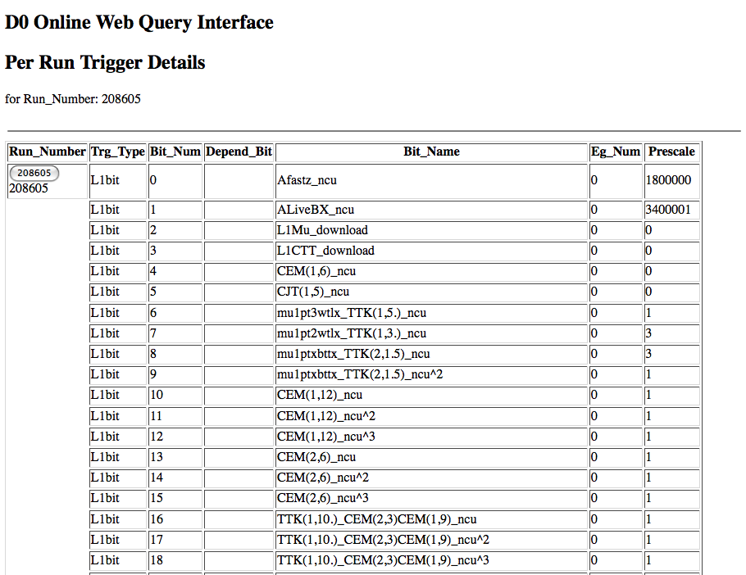

Slide 23
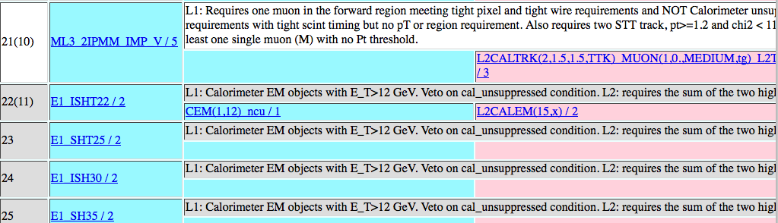
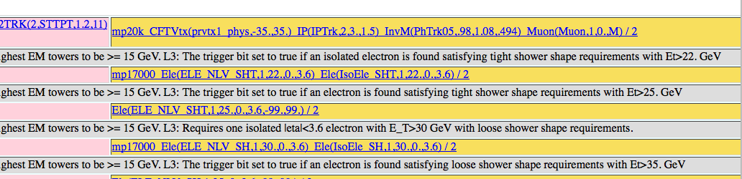
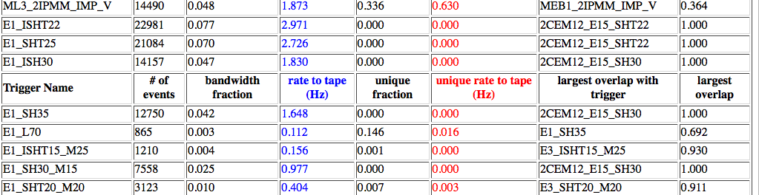

Slide 24
What else?
The word on the grapevine
Conclusions

Slide 25
Last remarks
With the 2009 run there will come the need to provide reliable and user-friendly tools to analyse trigger data
  Part of this exists but hasn’t been stressed, and part is under development
This workshop provided the physics groups with a good reason to re-visit their trigger studies, after the CSC exercise was finished – this should continue!
What else is missing? (Lots of things for sure! Would be good to find them early!)
  E.g. easier comparison between online and reconstruction quantities
    matching between online and offline objects?
  What else?

Slide 26



Fictional tool!
not planned…
The GrapeVine Browser
Latest:
2/3/2011: e22i_loose – L2 passthrough factor changed from 0 to 1k from run 991202
12/1/2011: FCAL fixed – FJ triggers back into menu (from SMK 4509152)
12/12/2010: new luminosity correction - new numbers in DB
11/12/2010: optimized cuts in all electron chains – from SMK 4509099
Search: (powered by Google)
e10_loose
Search
* Cut calo gaps from eta=1.37 to 1.52, otherwise you’ll get wrong efficiency
* e10i_loose changed dramatically in September 2010: check out your offline cuts
Slice:
Level:
Chain:
From:
e/gamma
L2
L2_e10_loose
Sep.09

Slide 27
Backup slides

Slide 29
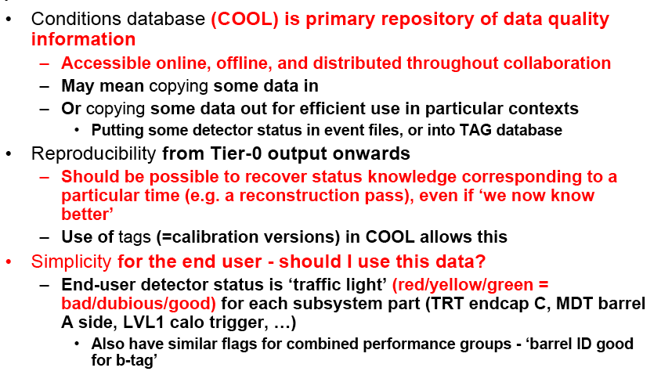
Notes…

Slide 30
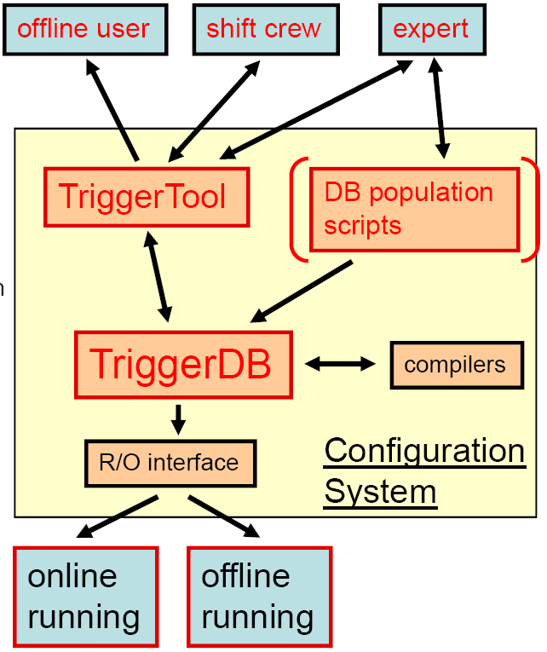
Configuration
Trigger configuration:
  Active triggers
  Their parameters
  Prescale factors
  Passthrough fractions
  Consistent over three trigger levels
Needed for:
  Online running
  Event simulation
  Offline analysis
Relational Database (TriggerDB) for online running
  User interface (TriggerTool)
  Browse trigger list (menu) through key
  Read and write menu into XML format
  Menu consistency checks
After run, configuration becomes conditions data (Conditions Database)
  For use in simulation & analysis

Slide 31
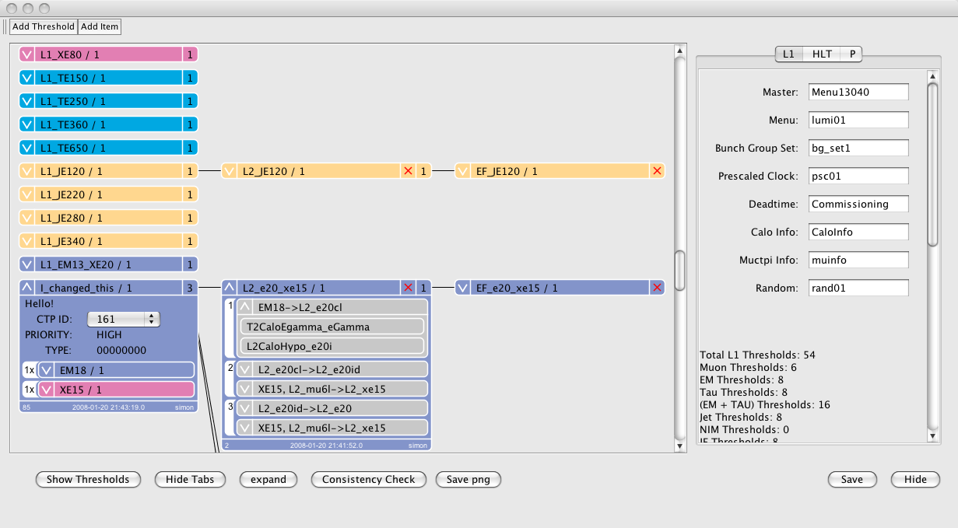
Viewing and Modifying a Menu
L1 Items in menu
L2 chains in menu
EF chains in menu
Record names
Menu can be edited by clicking the object
Some useful statistics
L1 Threshold
Steps
Input / Output Trigger Elements
Algorithms

Slide 32
Persistent object stored POOL
Only contains CTPDecision and HLTResult
Different configuration DB formats for different use cases: online, offline, AOD analysis
Until configuration from DB is available, persistify list of chains into event header. TrigConfigSvc provides common interface
Transient object
On request by Tool, expands and caches Configuration and Navigation information
TrigDecisionTool: user interface; unpacks and interprets TrigDecision through configuration info
TrigConfigSvc
Common interface to several configuration DB implementations
TrigDecision
transient object
T/P
converter
TrigDecision_p1
persistent object
unpack
TrigDecisionTool
user interface
TrigConfigSvc
XML
COOL
AOD header

