Slide 1

H->bb Weekly Meeting
Ricardo Gonçalo (RHUL)
HSG5 H->bb weekly meeting, 16 August 2011

Slide 2
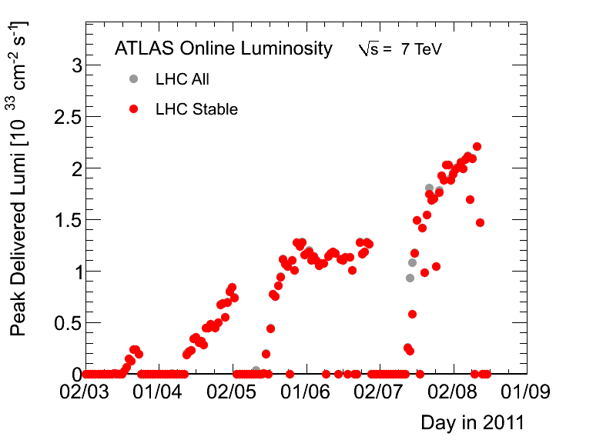
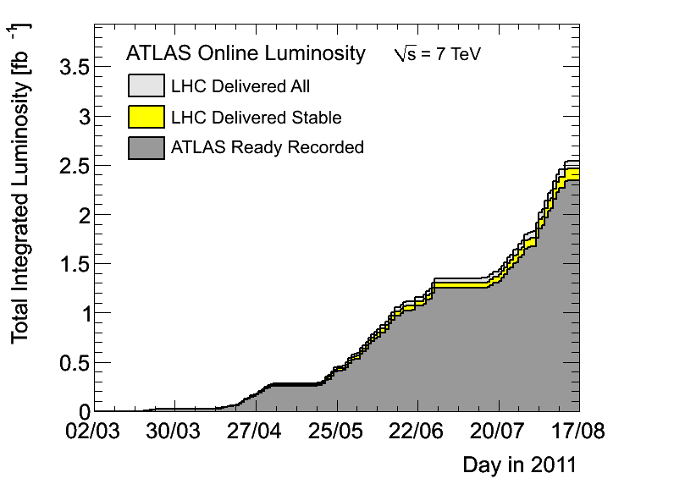
News! News! News!
Peak stable lumi 2.2x10³³cm⁻²s⁻¹
LHC delivered about 0.5fb⁻¹ in one week!
2.3fb⁻¹ with stable beams collected so far
Peak pileup around 12 – 13
1380 bunches in the machine – maximum for 50ns

Slide 3
News! News! News!
Our H->bb poster for LP2011 got cancelled for lack of presenter… ☹
It turned out that Dilip could not present 2 posters (he was already presenting one for HSG3)

Slide 4
News! News! News!
Top group tools
Some uniformization of non-Athena code is being tried by the top group:
  Using RootCore package to provide a common way to build Root-based code for top analyses.
  See: https://twiki.cern.ch/twiki/bin/view/AtlasProtected/TopRootCore
Benefits:
  Most of the Makefile is written in one place
  Dependencies are resolved and the packages are built automatically in order
  Given one package the others are checked out as needed
  All package dependencies can be built in one go

Slide 5
News! News! News!
Fast simulation workshop
  Fast simulation will be more and more needed with increased statistics
  Already successfully used for SUSY results for EPS
  Workshop dedicated to fast simulations and the new integrated simulation framework on 7th September 2011:
    https://indico.cern.ch/conferenceDisplay.py?confId=150893

Slide 6
News! News! News!
Trigger problems in run 186729
Prescale information on run 186729 is wrong in AODs, ESDs and D3PDs filled using TrigDecisionTool
Trigger decision information is correct
Luminosity information for this run should only be obtained from LumiCalc: https://atlas-datasummary.cern.ch/lumicalc/
This problem will be corrected in rel.17 reprocessing

Slide 7
Trigger! Be worried! Be very worried!
Disabled or prescaled from run 186873:
2b10_medium_4L1J10
2b10_medium_L1_2J10J50
2b10_medium_3L1J20
2e12_medium
2mu4_DiMu
3b15_loose_4L1J15
3j75_a4tc_EFFS
L1FJ75_NoAlg
e15_medium_e12_medium
e20_loose
e20_loose1
e20_looseTrk
e20_medium
e20_medium1
e20_medium2
e20_medium_SiTrk
e20_medium_TRT
e7_tight_e14_etcut_Jpsi
g40_loose_EFxe40_noMu
ht350_a4tc_EFFS_L2je255
j100_a4tc_EFFS_ht350
j75_2j30_a4tc_EFSF_ht350
j75_j30_a4tc_EFFS_anymct150
j75_j30_a4tc_EFFS_anymct175
mu15i_medium
tau100_medium
tau125_medium
tau16_loose tau16_loose_e15_medium
tau16_loose_mu15
tau16_medium_mu10 tau29_loose
Higher-threshold triggers in use since period K
  3x10³³ prescale set used since 4th August, run 186873
  Several combined MET chains and and L1_MU10 unprescaled in last part of each fill
Single-electron triggers will use isolation
  Problem for fake electron background estimation
  Nice page from Will Bell (top group) with list of planned studies: https://twiki.cern.ch/twiki/bin/view/AtlasProtected/FakeLeptonTriggers
A new sample T was just produced for trigger studies
  Using AtlasTrigMC 16.6.7.7.1 cache; AMI tag: r2597
  Sample names start with "valid”: valid1.*.recon.AOD.e598_s933_s946_r2597_tid…
  Useful for looking at recent changes for the 3e33 menu (e.g. e22_medium, e22_medium1, etc)
  Similar sample may be produced with 17.0.X.Y if there’s enough popular demand
  See: https://twiki.cern.ch/twiki/bin/viewauth/Atlas/TriggerSampleT

Slide 8

Data skims for H->bb
We need to have data skims to avoid pain of running over too much data – both for inclusive and boosted analyses (ZH inclusive already using HSG2 skims)
Plan to join the DPD train:
  The code to produce DAODs or D3PDs should be in AtlasPhysics cache and fully tested
  The production needs to be done with a single Reco_trf.py instruction (fully tested standalone)
  Write the data to Higgs group space
  DPD production done in Tier1 from AODs
  Skims should be small enough for this to make sense
Once code is running, need to get the ok from the Higgs conveners and production manager
Should test asap on rel.16 AODs to be ready for production after reprocessing
Any news on the skimming code?

Slide 9
Releases, data and Monte Carlo
All 2011 data will be reprocessed with rel.17
  We should move to rel.17 and MC11 asap
  Rel.17 MC11A validation samples available: tag r2585, 17.0.2.7
MC samples:
  Missing a few inclusive signal (WH/ZH) samples
    135GeV for WH and ZH (since we have 130 and 140)
    Extend up to 150GeV? (σ×BR ≈0.05 – 10× smaller than at 115GeV)
    Re-do WH samples at 110 and 140 since the current ones were done with a lepton filter by mistake
  MC samples for boosted channels
    Wbb background with Sherpa to compare to Alpgen
      How much do we need? Who will prepare job options?
    Boosted VH signal
      Only have WH (Herwig, m_{H}=120GeV, p_{T}^{H}>150GeV) at the moment
      What’s the status of this?
    ttH? VBF?

Slide 10
Backup Slides

Slide 11
Post-mortem of WH/ZH results
M_{bb} resolution is extremely poor
  Should try to get a peak, but this needs work on jet (and b-jet) energy scale
  Try to think about this together with jet/E_{T}^{miss} people
  Could we improve other things in jet reco to improve m_{bb}?
  In ZH->llbb could try to use ll vs bb p_{T} balance to do in-situ calibration?
B-tagging systematic uncertainty dominates by far
  16% vs 7-9% for JES and ≈1-2% others
  Should be possible to improve this, since the error is dominated by the statistics used in b-tagging studies
  Would improve limits by up to 25-30%
  Think about this with b-tagging people
Limits: must get help from roostats experts to understand the difference between expected and observed
WH cuts on exactly 2 jets
  A lot of signal is lost there – can it be improved?
WH backgrounds:
  Top and W+jets background estimate using simultaneous template fit to m_{bb} sidebands (<80GeV and 140-250GeV)
  Probably should try to also constrain jet energy scale from this fit
  JES changes m_{bb} distribution and could affect normalization of backgrounds
  In light of H->WW results, should move upper sideband to e.g. 160-250GeV – at m_{H}=150GeV, σ*BR already 1/10 of value at 115GeV, but H->WW and H->bb resolution is very broad
  Can top background be reduced further?
ZH background from Z+bb seems irreducible – can it be improved?

Slide 12
WH/ZH analysis plans
We can still try to improve cut based analysis:
  Get a m_{bb} peak, improve b-tagging systematics, constrain JES in WH, etc…
  Reduce top background in WH:
    Try using looser leptons or extending lepton id to forward region to veto tt->lvlvbb
    Loosen jet η cut (at |η|<2.5 now) and maybe p_{T} cut to veto tt->lvjjbb/jjjjjbb
  But… must keep pileup and JVF in mind
Reduce Z+bb background in ZH? Would probably need a clever new variable like cos*θ
Then clearly we should include multivariate methods
  Used intensively by Tevatron
  e.g. use NN to target top background – may allow to relax 2-jet cut in WH
  NN may also help in rejecting Z+bb background in ZH?
  See if MV method can improve existing b-tagging
Add more channels!
  Can something be done with ZH->ννbb? Very good channel in Tevatron, but complex and mature analysis
    Academia Sinica group plans to work on this But trigger is the crucial part
  Boosted VH is clearly the next thing to push! WH->lνbb and ZH->llbb, but also ZH->ννbb
    UCL and Edinburgh working on this – should be enough manpower now, but need to get results soon
  ttH has been slowly building up in Glasgow – will push for this to happen together with Chris

Slide 13
Boosted VH Data Format
Had a phone meeting two weeks ago to discuss a common D3PD format for boosted VH analyses
Will use “official” Jet/ETmiss D3PD maker code by Bertrand Capleau to produce SM W/Z D3PDs including jet substructure variables
  https://twiki.cern.ch/twiki/bin/view/AtlasProtected/GroomedJetsD3PD
  Filtered Cambridge-Aachen jets and their constituent jets etc
  Need to run b-tagging on sub-jets
  Edinburgh (Robert H.) working on this with help from UCL
Then the idea is to make data skims to ease running on new data

