Slide 1

H->bb Weekly Meeting
Ricardo Gonçalo (RHUL)
HSG5 H->bb Weekly Meeting, 22 March 2011

Slide 2
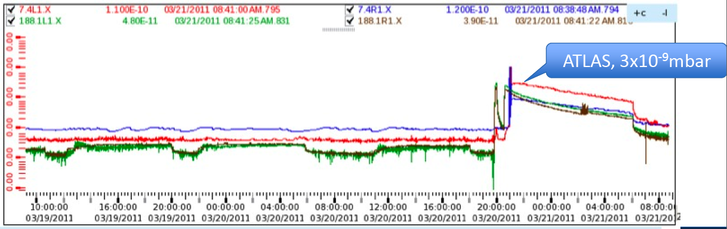
News! News! News!
Currently 136 bunches in 7 trains (+ pilot) – 450 GeV and 3.5 TeV
Collected data without magnetic field during weekend
  Solenoid now up, but toroid still down for μ alignment run
Good beam lifetimes (≈50h) but vacuum spike in ATLAS (up to 10⁻⁶mbar) not yet understood
  Clear e-cloud effect (up to 10⁻⁸mbar in IP8) – e-cloud-protection solenoids are still OFF until technical stop

Slide 3
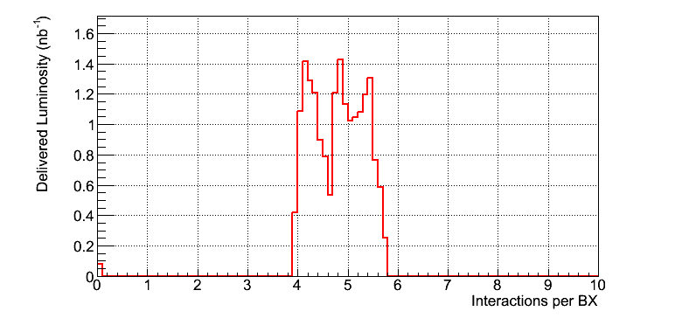
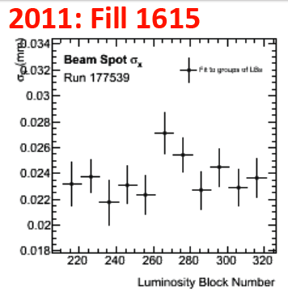
The story so far…
See Beate’s talk at the last weekly: http://indico.cern.ch/getFile.py/access?contribId=3&resId=0&materialId=slides&confId=119629
Luminosity per bunch ≈1.3 times larger than in last 2010 runs (smaller β* now)
Overall luminosity normalization not yet fully understood
  Differences of 5‐10% seen between different algorithms
  The 3.4% uncertainty from last year not directly applicable for 2011
Beamspot ≈2 times smaller than in 2010
Pileup peak values up to μ = 5.8 found
  No values below 2.8
  This agrees to within 10% with expectation given machine parameters
  Highest value in 2010 was 4.7

Slide 4
Data Distribution Model
…or life without the ESD
2011/2012 plan for the distribution of data coming into effect – described here: http://cdsweb.cern.ch/record/1335459
ESDs for bulk physics streams will only be available for a fixed time period (initially 6 weeks)
Analyses concerned need to change to either DESDs or AODs
DESD content described here: https://twiki.cern.ch/twiki/bin/view/AtlasProtected/PerformanceDPD

Slide 5
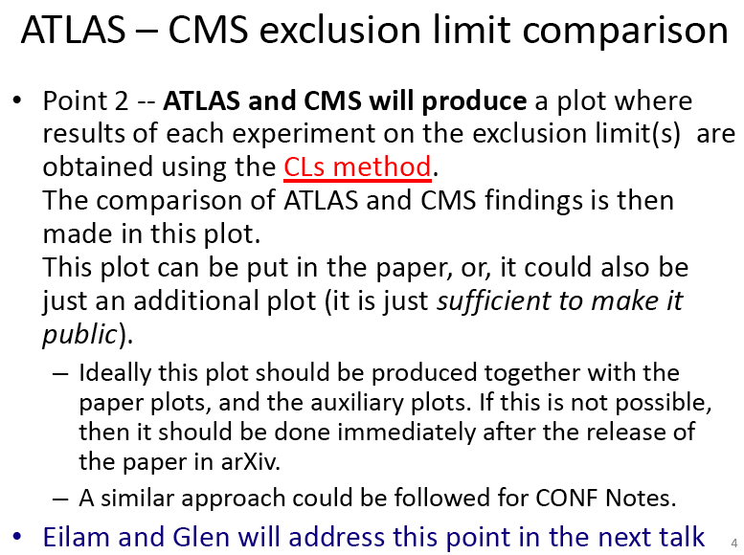
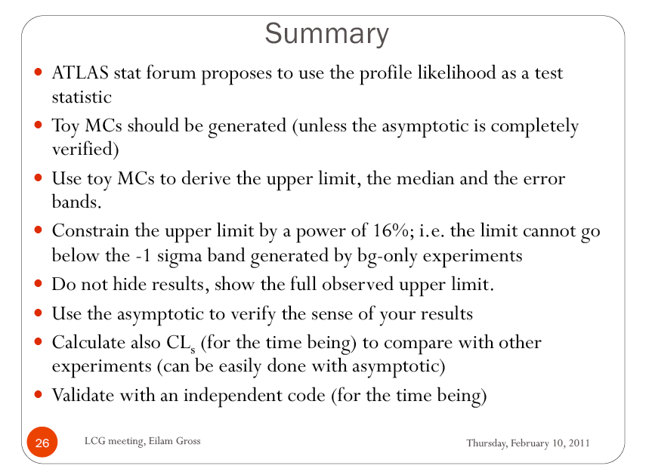
Physics-Statistics meeting
Preliminary meeting on procedure for ATLAS-CMS exclusion limits last week: http://indico.cern.ch/conferenceDisplay.py?confId=131204
New meeting (probably this Friday) to continue discussion

Slide 6
News! News! News!
Other news & etc:
Foreseen trigger menu and expected rates can be found here: https://aagaard.web.cern.ch/aagaard/Rates/Mar01.html
  Please remember to check also list of triggers in HSG5 validation (backup slides)
Discussion on jet-electron overlap removal for W/Z measurements in SM group (conclusions?):http://indico.cern.ch/conferenceDisplay.py?confId=131538
Meeting on W + heavy flavour jet analysis tomorrow: https://indico.cern.ch/conferenceDisplay.py?confId=131971

Slide 7
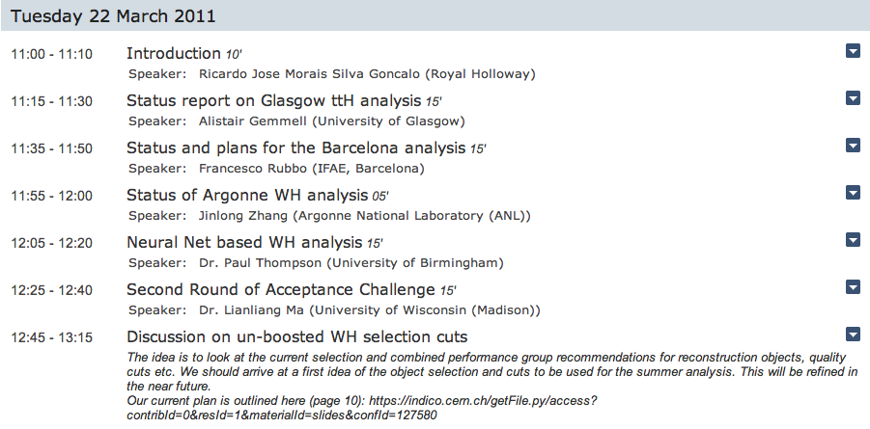
Today…
Charged agenda! Good!
Status reports on ttH analyses from Glasgow and Barcelona
Status reports on WH analyses
  Including cut-based and multivariate analyses
  Discussion on WH selection – important! Should try to conclude on this in ≈1 week (see “roadmap wish list” in backup slides)

Slide 8
Backup

Slide 9
HSG5 Validation
Arnaud asks how to update the Trigger menu in the HSG5 validation package
Triggers currently being monitored:
  L1 Triggers: L1_MU10, L1_MU15, L1_MU20_XE30, L1_EM10, L1_EM14, L1_EM18_XE30, L1_TAU9I_3J5_2J20, L1_TAU9_XE15, L1_XE40
  L2 Triggers: L2_mu10, L2_mu15, L2_mu20_xe30, L2_e10_medium, L2_e15_medium, L2_e20_loose, L2_e20_loose_xe30, L2_tau16i_loose_3j30, L2_tau16_loose_xe20, L2_xe40
  Event Filter Triggers: EF_mu10, EF_mu15, EF_mu20_xe30, EF_e10_medium, EF_e15_medium, EF_e20_loose, EF_e20_loose_xe30, EF_tau16i_loose_3j30, EF_tau16_loose_xe20, EF_xe40
Several of these are already obsolete…
Please check what your triggers will be for 2011 (until Summer) and let us know

Slide 10
Proposed Roadmap for WH Analysis
After the effort on cut flows, we’re ready to start producing results!
  Concentrating on un-boosted results here only because it’s still unclear what would be feasible in boosted analysis until Dubna – commissioning work ongoing
  BUT: work on boosted VH is starting in parallel – see e.g. Wahid’s talk today
Intended results:
  Cut-based analysis focusing on WH -> e/μ ν b b
    I think there should be at least 2 analyses, for cross checking results
    Ideally using 2 different data formats (AOD vs D3PD)
  Multivariate analysis in parallel, to improve on cut-based analysis
Timeline:
  Analyses should be semi-frozen by Dubna (17 – 19 May)
  This leaves around 7 weeks
Results in the form of:
  Histogram with # events vs m_{H}
  Table of # events expected for each value of m_{H} and background type – including statistical and systematic uncertainties
  Exclusion plot vs m_{H} (95% C.L. limit on σ/σ_{SM})
  …plus control plots etc

Slide 11
Questions to be answered
Cut-based analysis focusing on WH -> e/μ ν b b
  Establish analysis selection: why is each cut applied and why at each particular value? Are we convinced this is the right thing to do?
  Establish set of systematic uncertainties: start from combined performance group recommendations. What are the most important? Are there any hidden pitfalls for us?
  What b-taggers and why? What calibrations do we expect to be ready in time? What is the corresponding systematic uncertainty?
  What sort of exclusion limits can we expect for 0.5, 1, 2 fb⁻¹ ?
Multivariate analysis in parallel, to improve on cut-based analysis
  What event preselection should be used and why?
  Use for signal-background separation only or target particular backgrounds?
  What are the possible bias? Where can it go wrong?
  What improvement can be expected wrt cut-based analysis for 0.5, 1, 2 fb⁻¹ ?
Exclusion plot vs m_{H} (95% C.L. limit on σ/σ_{SM})
  Need someone to implement RooStats workspace

Slide 12
Date | Milestones wish list
17 May | Dubna workshop – analysis frozen After this: add data to un-boosted analysis and prepare for result approval Concentrate more effort on boosted VH with a view to obtaining results quickly
10 May | Review results with 2011 data from cut-based and multivariate analyses
3 May | Margin for dealing with unforeseen problems
26 April | Start looking at 2011 data if enough is available. Any surprises? How does the MC describe the new data? By now we should have a reasonable idea of results from the multivariate analysis
19 April | End of 2 weeks of beam scrubbing. (I’m away for Easter)
12 April | By now we should have a reasonable idea of the exclusion of the cut-based analysis First report on MVA preliminary results – establish plan for getting results by Dubna
5 April | Identify the worst systematics and discuss any possible improvements: Any changes needed in analysis cuts? Any study necessary for corrections to some systematic effect? Multivariate analysis: iterate on preselection cuts, methods, questions Assign tasks – divide the work to achieve better results!
29 March | Establish analysis cuts: If possible as result of optimization Use 2010 data to develop cuts and show that data is well described by background MC Start evaluating systematics
22 March | Iterate on analysis cuts – why is each cut applied at each particular value? Start iteration on multivariate methods to improve analysis

Slide 13
Reconstruction issues
Muon CP group recommendations for release 16:
  Reconstruction efficiency and isolation efficiency scale factors, momentum smearing functions
  https://twiki.cern.ch/twiki/bin/view/AtlasProtected/MCPAnalysisGuidelinesRel16
Jet/Etmiss recommendations for jet cleaning in release 16:
  Medium jet cleaning should give similar rejection to rel 15 cleaning but with better efficiency
  Tight jet cleaning should not be used – still under discussion
  https://twiki.cern.ch/twiki/bin/view/AtlasProtected/HowToCleanJets#Bad_jets_rel16_data
New!: Final b-tagging calibrations for release 16 based on full 2010 data:
  https://twiki.cern.ch/twiki/bin/view/AtlasProtected/Analysis16
e/gamma recommendations for energy scale and resolution in release 16:
  https://twiki.cern.ch/twiki/bin/view/AtlasProtected/EnergyScaleResolutionRecommendations
  And rescaler tool: https://twiki.cern.ch/twiki/bin/view/AtlasProtected/EnergyRescaler
Standard Model W/Z group baseline selection for release 16 (next 4 slides):
  See discussion in W/Z group Sharepoint
  Also, finer points (and perhaps the not so fine) still being discussed

Slide 14
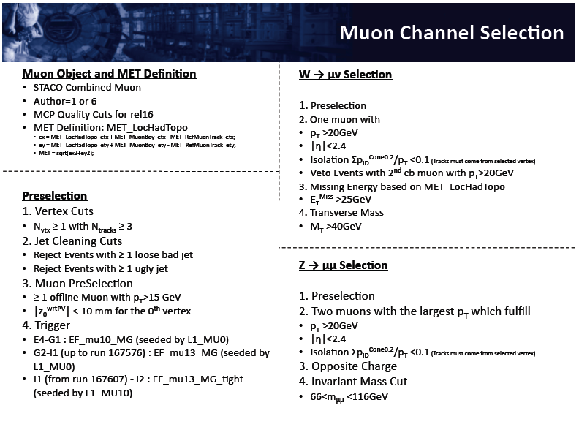

Slide 15
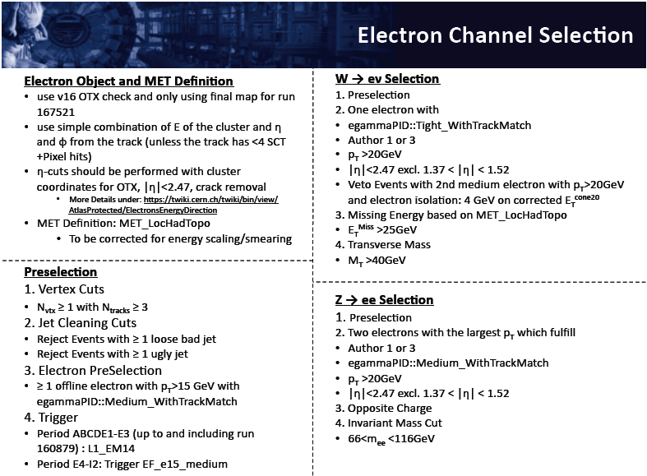

Slide 16
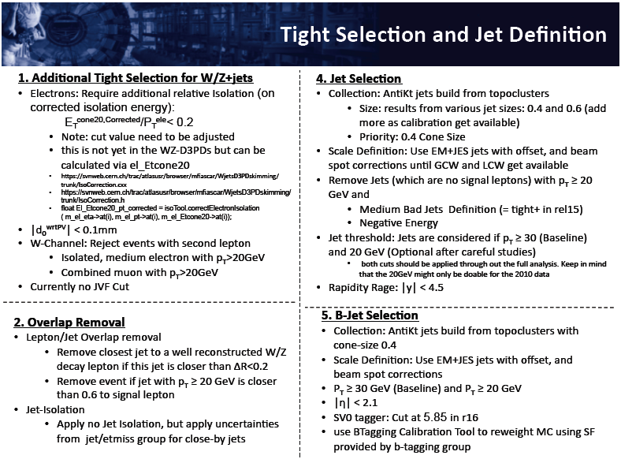

Slide 17
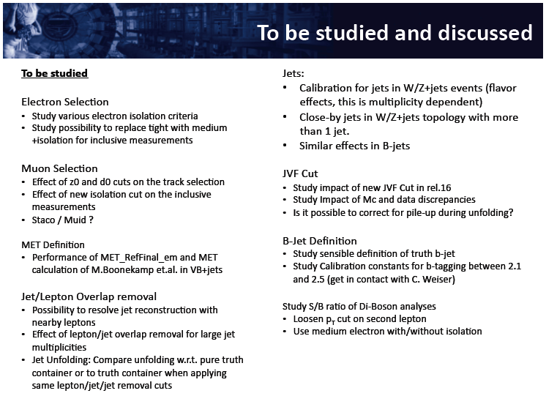
Future changes in W/Z baseline selection

