Slide 1
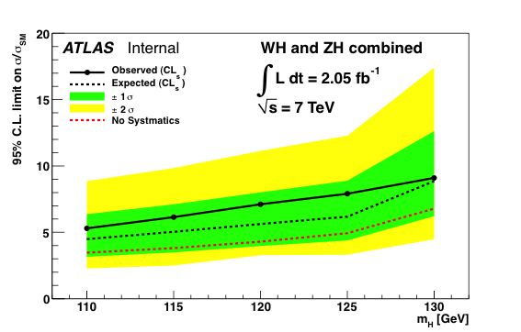
HSG5
Monte Carlo:
  Signal: new Powheg signal samples in MC11b with priority 1
  Backgrounds:
    Top: mostly priority 0/1 except single top (2)
    WW/WZ/ZZ: ok; ≈10 x 5fb⁻¹, priority 0
    W+jets/h.f., Z+jets: priority 0, L_{MC} ≈ 2 x 5fb⁻¹
    Z+h.f. priority 1 and good stats (≈ 10 x 5fb⁻¹)
    QCD: bb, cc ≈ 1% of 5fb⁻¹
Analyses for December:
  WH->lνbb and ZH->llbb may be ready
    Availability of MC is the main obstacle so far
    Not clear yet on b-tagging and JES/JER corrections and and uncertainties
    Encouraging results in rel.16 after optimization
  ZH->ννbb probably won’t make it:
    Missing background MC
    Analysis not yet mature
  Need to find good solution for limit setting and combination
    Probably bad idea but… would like to have common setup to build workspaces and run limit calculations to be used in HSG5 – starting from common set of histogram (fixed names)
A.Mehta
AOB:
  Nothing new on CP issues in past week
  D3PD skims starting to appear and being debugged
  At the same time planning MC samples for later analyses

